Slide 1
Chapter 15 Transmission Control Protocol (TCP)

Slide 2
Outline
TCP Services
TCP Features
Segment
A TCP Connection
State Transition Diagram
Windows in TCP
Flow Control
Error Control
Congestion Control
TCP Timers
Options
TCP Package

Slide 3
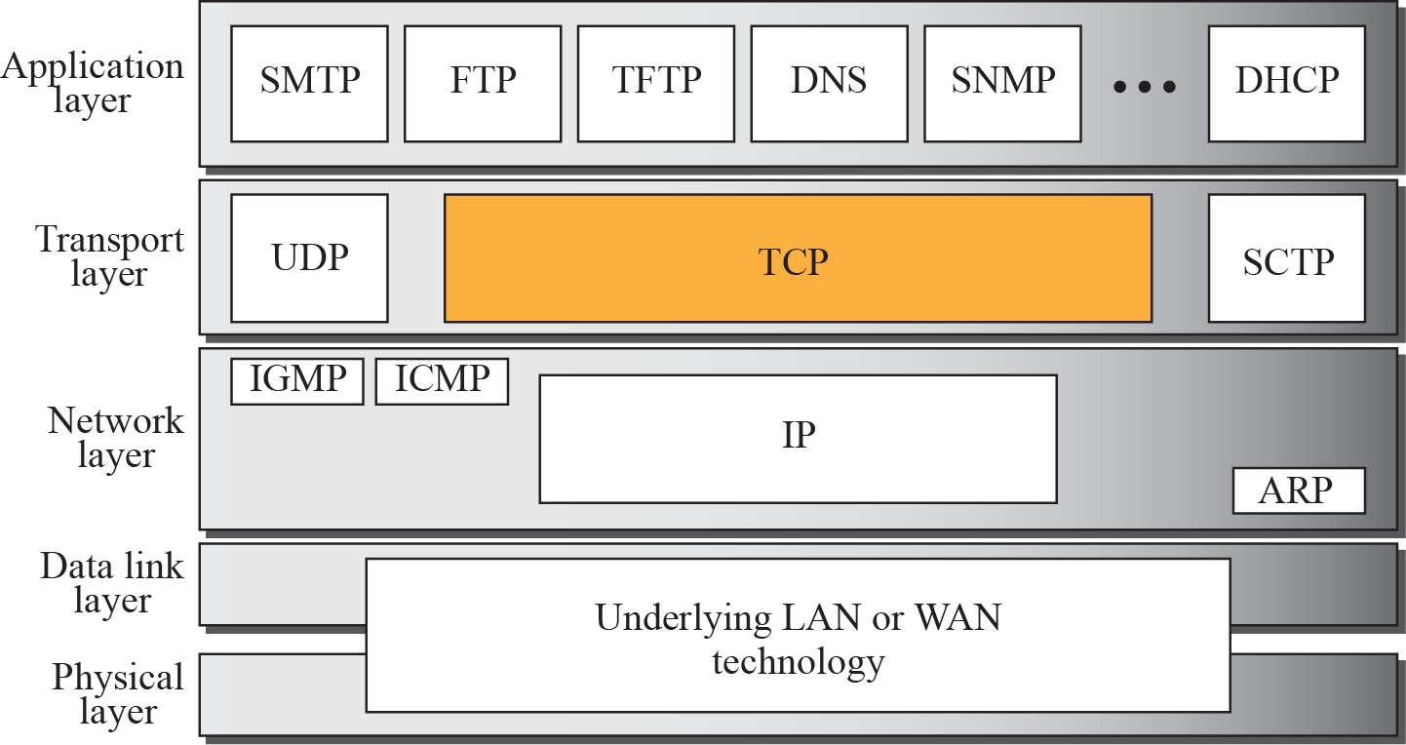
Figure 12-1
Position of TCP in TCP/IP Protocol Suite
The McGraw-Hill Companies, Inc., 2000

Slide 4
12.1 TCP SERVICES
We explain the services offered by TCP to the processes at the application layer.
The topics discussed in this section include:
Process-to-Process Communication
Stream Delivery Service
Full-Duplex Communication
Multiplexing and Demultiplexing
Connection-Oriented Service
Reliable Service

Slide 5
TCP Services
TCP provides services to the processes at the application layer
Process-to-Process Communication
Stream Delivery Service
Full-Duplex Service
Multiplexing and Demultiplexing
Connection-Oriented Service
Reliable Service

Slide 6
Process-to-Process Communication
Like UDP, TCP provides process-to-process communication using port numbers

Slide 7
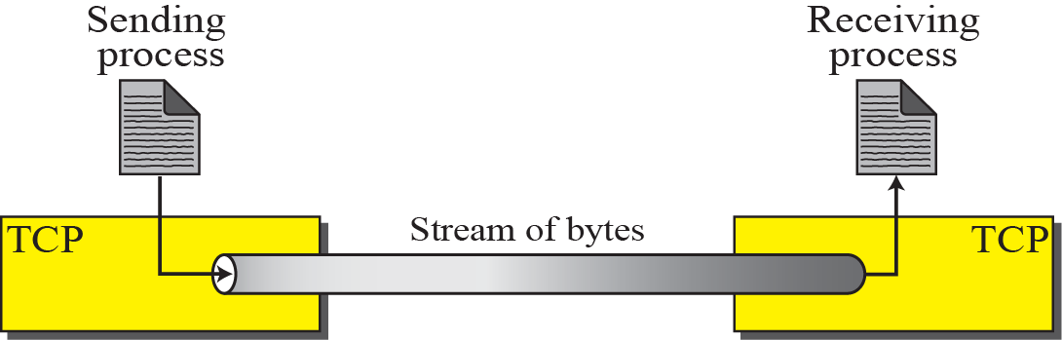
Stream Delivery Service
UDP treats each chunk independently
No any relationship between the user datagrams
In contrast, TCP allow the data be delivered and received as a stream of bytes

Slide 8
Stream Delivery Service (Cont.)
However, the sending and receiving speed may not be the same
TCP needs buffers for storage
Two buffers in TCP
Sending buffer and receiving buffer, one for each connection
Also used in flow- and error-control mechanisms

Slide 9
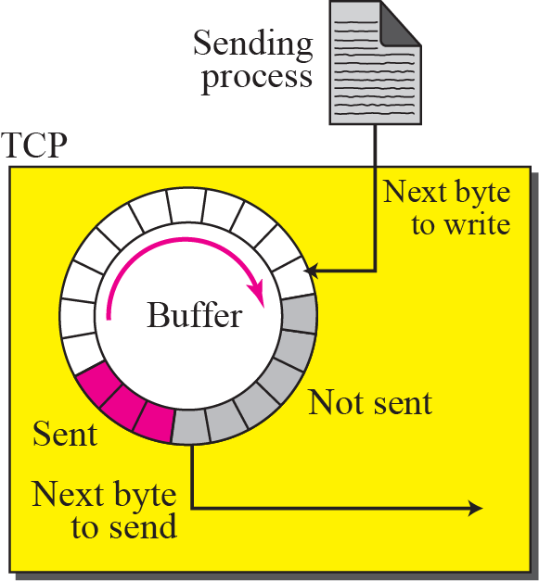
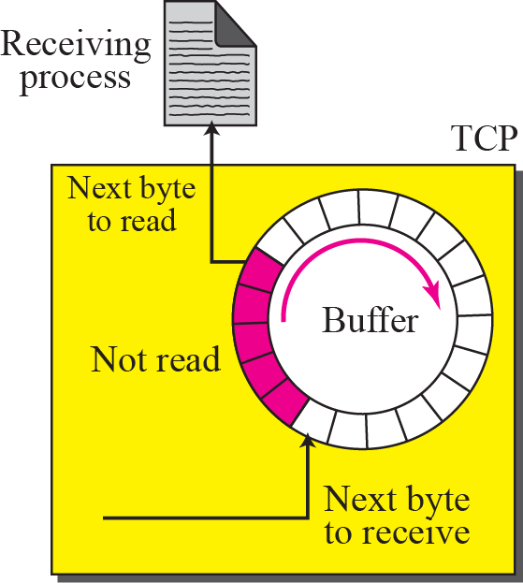
Figure 12-5
Sending and Receiving Buffers
The McGraw-Hill Companies, Inc., 2000

Slide 10
Sending Buffers
The sending circular buffer has three types of sections
White section: empty location
Can be filled by the sending process
Color section: hold bytes that have been sent but not yet acknowledged
TCP keeps these bytes until it receives acknowledges
Gray section: bytes to be sent by the sending TCP
TCP may be able to send only part of this grayed section
The slowness of the receiving process
The congestion in the network

Slide 11
Receiving Buffer
The receiving circular buffer is divided into two areas
White area:
Empty locations to be filled
Colored area:
Contain received bytes that can be consumed by the receiving process

Slide 12
Segments
TCP groups a number of bytes together into a packet called a segment
A TCP packet is called a segment
TCP adds a header to each segment
Then, the segments are encapsulated in an IP datagram
Note: terms
UDP: User Datagram, TCP: Segment
IP: Datagram
MAC : Frame

Slide 13
Figure 12-6
TCP Segments
The McGraw-Hill Companies, Inc., 2000

Slide 14
Full-Duplex Communication
TCP offers full-duplex service
Data can flow in both directions at the same time
Each TCP has a sending and receiving buffer and segments are sent in both direction

Slide 15
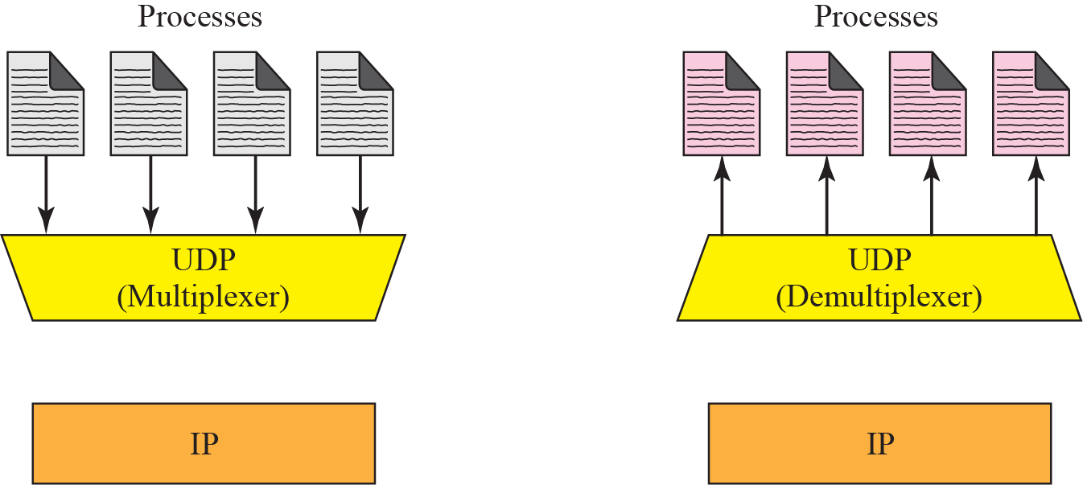
Multiplexing and Demultiplexing
TCP
TCP

Slide 16
Connection-Oriented Service
TCP is a connection-oriented protocol
However, the connection is virtual, not a physical connection
Each TCP segment may use a different path to reach the destination

Slide 17
Reliable Service
TCP uses an acknowledge mechanism to check the safe and sound arrival of data

Slide 18
Outline
TCP Services
TCP Features
Segment
A TCP Connection
State Transition Diagram
Windows in TCP
Flow Control
Error Control
Congestion Control
TCP Timers
Options
TCP Package

Slide 19
12.2 TCP FEATURES
To provide the services mentioned in the previous section, TCP has several features that are briefly summarized in this section.
The topics discussed in this section include:
Numbering System
Flow Control
Error Control Congestion Control

Slide 20
Numbering Bytes
Although TCP use segments for transmission and reception
There is no field for a segment number in the segment header, i.e., TCP header
TCP uses sequence number and acknowledgement number to keep track of the segment being transmitted or received
Notably, these two fields refer to the byte number, not the segment number

Slide 21
Byte Numbers
TCP numbers all data bytes that are transmitted in a connection
The numbering does not necessarily start from 0
It starts randomly
Between 0 and 2^32 – 1 for the number of the first byte
Byte numbering is used for flow and error control

Slide 22
Sequence Number
TCP assigns a sequence number to each segment
The sequence number for each segment is the number of the first byte carried in that segment

Slide 23
Example 15.1
Suppose a TCP connection is transferring a file of 5000 bytes. The first byte is numbered 10001.
What are the sequence numbers for each segment if data is sent in five segments, each carrying 1000 bytes?

Slide 24
Solution
The following shows the sequence number for each segment:
Segment 1 ➡ Sequence Number: 10,001 (range: 10,001 to 11,000)
Segment 2 ➡ Sequence Number: 11,001 (range: 11,001 to 12,000)
Segment 3 ➡ Sequence Number: 12,001 (range: 12,001 to 13,000)
Segment 4 ➡ Sequence Number: 13,001 (range: 13,001 to 14,000)
Segment 5 ➡ Sequence Number: 14,001 (range: 14,001 to 15,000)

Slide 25
Acknowledgment Number
Each party numbers the bytes, usually with a different starting byte number
Sequence number: the number of the first byte carried by the segment
Acknowledgment number: the number of the next byte that the party expects to receive

Slide 26
Acknowledgment Number (Cont.)
Acknowledgment number is cumulative
For example, if a party uses 5,643 as an acknowledgment number
It has received all bytes from the beginning up to 5,642
Note that, this does not mean that the party has received 5642 bytes
The first byte number does not have to start from 0

Slide 27
Flow Control
The receiver controls how much data are to be sent by the sender
Prevent the receiver from being overwhelmed with data
The numbering system allow TCP to use a byte-oriented flow control

Slide 28
Error Control
TCP implements an error control mechanism
To provide reliable service
Also byte-oriented

Slide 29
Congestion Control
TCP takes into account congestion in the network
Thus, the amount of data sent by a sender is controlled both by
The receiver (flow control)
The level of congestion in the network (congestion control)

Slide 30
Outline
TCP Services
TCP Features
Segment
A TCP Connection
State Transition Diagram
Windows in TCP
Flow Control
Error Control
Congestion Control
TCP Timers
Options
TCP Package

Slide 31
12.3 SEGMENT
A packet in TCP is called a segment
The topics discussed in this section include:
Format
Encapsulation

Slide 32
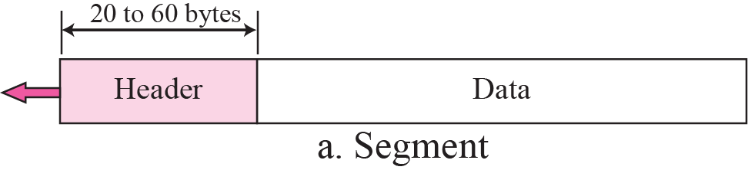
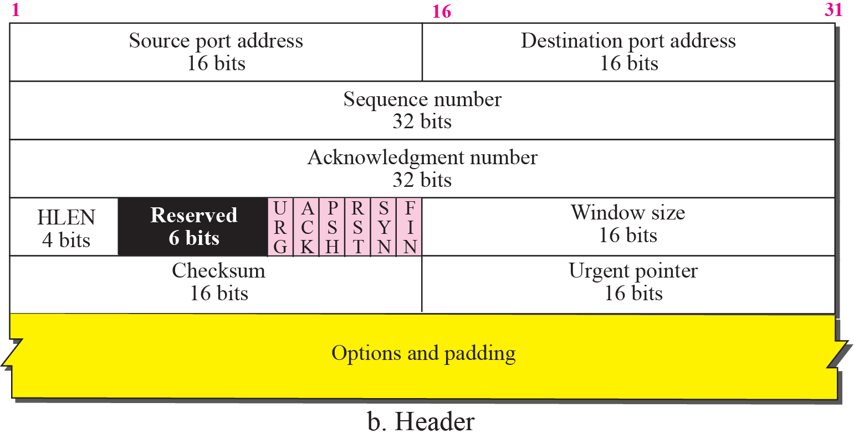
Figure 12-19
TCP Segment Format
The McGraw-Hill Companies, Inc., 2000

Slide 33
TCP Segment Format
Source port address: 16-bit
Destination port address: 16-bit
Sequence number: 32-bit
The first byte number in this segment
In connection establishment, each party randomly generate an initial sequence number (ISN)
Usually different in each direction
Acknowledgment number: 32-bit
The byte number that the receiver expects
If received byte number x, ack. number is x+1
Acknowledgment and data can be piggybacked together

Slide 34
TCP Segment Format (Cont.)
Header length: 4-bit
The number of 4-byte words in the TCP header
Value of this field is between 5 and 15
TCP header is between 20-60 bytes
Reserved: 6-bit
Reserved for future use
Control: 6-bits

Slide 35
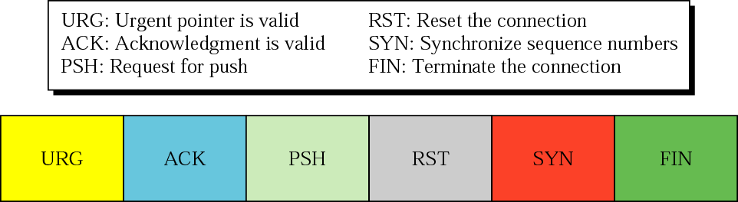
Figure 12-20
Control Field
The McGraw-Hill Companies, Inc., 2000

Slide 36
TCP Segment Format (Cont.)
Control
URG: urgent pointer is valid
ACK: acknowledgment field is valid
PSH: push the data
RST: the connection must be reset
SYN: Synchronization sequence numbers during connection
FIN: terminate the connection

Slide 37
TCP Segment Format (Cont.)
Window size: 16-bit
Define the size of the receiving window, in bytes
Determined by the receiver
The maximum window size is 2^16 - 1= 65535
Checksum: 16-bit
Follow the same procedure as UDP
Checksum for TCP is mandatory (UDP is optional)
Urgent pointer: 16-bit
Valid only if the urgent bit is set
Used when the segment contains urgent data
Options: 0~40 bytes

Slide 38
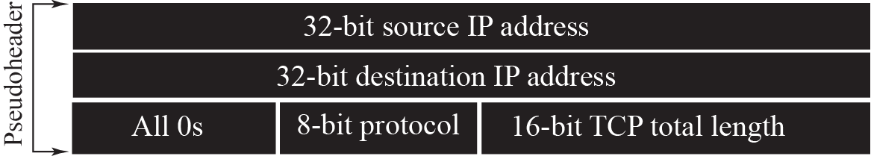
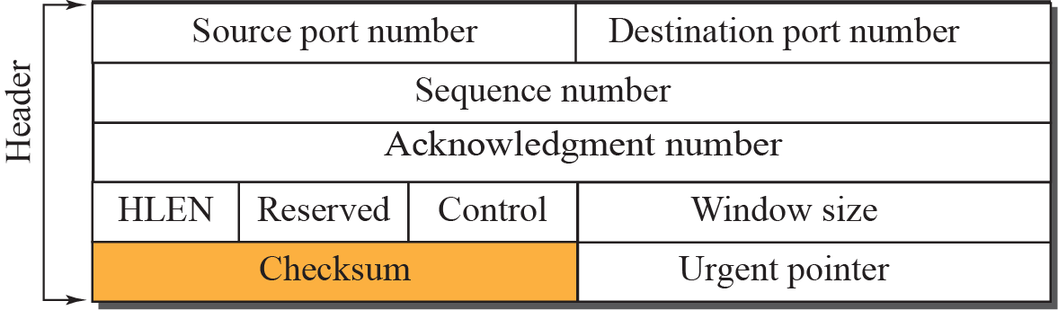

Pseudoheader Added to the TCP Datagram

Slide 39
Encapsulation
A TCP segment is encapsulated in an IP datagram
Which in turn is encapsulated in a data-link frame

Slide 40
Outline
TCP Services
TCP Features
Segment
A TCP Connection
State Transition Diagram
Windows in TCP
Flow Control
Error Control
Congestion Control
TCP Timers
Options
TCP Package

Slide 41
12.4 A TCP CONNECTION
TCP is connection-oriented. A connection-oriented transmission requires three phases: connection establishment, data transfer, and connection termination.
The topics discussed in this section include:
Connection Establishment
Data Transfer
Connection Termination
Connection Reset

Slide 42
Introduction
TCP is connection-oriented
Establishes a virtual path.
All of the segments are then sent over this virtual path.
TCP’s connection-oriented transmission requires three phases
Connection establishment
Three-way handshaking
Data transfer
Connection termination
Four-way handshaking

Slide 43
Connection Establishment
Four actions are taken between host A and B
Host A sends a segment to announce its wish for connection and includes its initialization information
Host B sends a segment to acknowledge the request of A
Host B sends a segment that includes its initialization information
Host A sends a segment to acknowledge the request of B
However
Step 2 and 3 can be combined into one step

Slide 44
Connection Establishment
Example, a client wants to make a connection to a server
Server performs the passive open
Tell TCP that it is ready to accept a connection
Client performs the active open
Tell TCP that it needs to be connected to the server

Slide 45
Three-way handshaking
The client sends the first segment, a SYN segment
Set the SYN flag
The segment is used for synchronization of sequence number
Initialization sequence number (ISN)
If client wants to define MSS, add MSS option
If client needs a larger window
Define the window scale factor option
Does not contain any acknowledgment number
Does not define the window size either
A window size makes sense only when a segment includes an acknowledgment
Although a control segment and does not carry data
But consumes one sequence number

Slide 46
Three-way handshaking (Cont.)
The server sends a second segment, a SYN + ACK segment
Set the SYN and ACK flag
Acknowledge the receipt of the first segment using the ACK flag and acknowledgment number field
Acknowledgment number = client initialization sequence number + 1
Must also define the receiver window size for flow control
SYN information for the server
Initialization sequence number from server to client
Window scale factor if used
MSS is defined

Slide 47
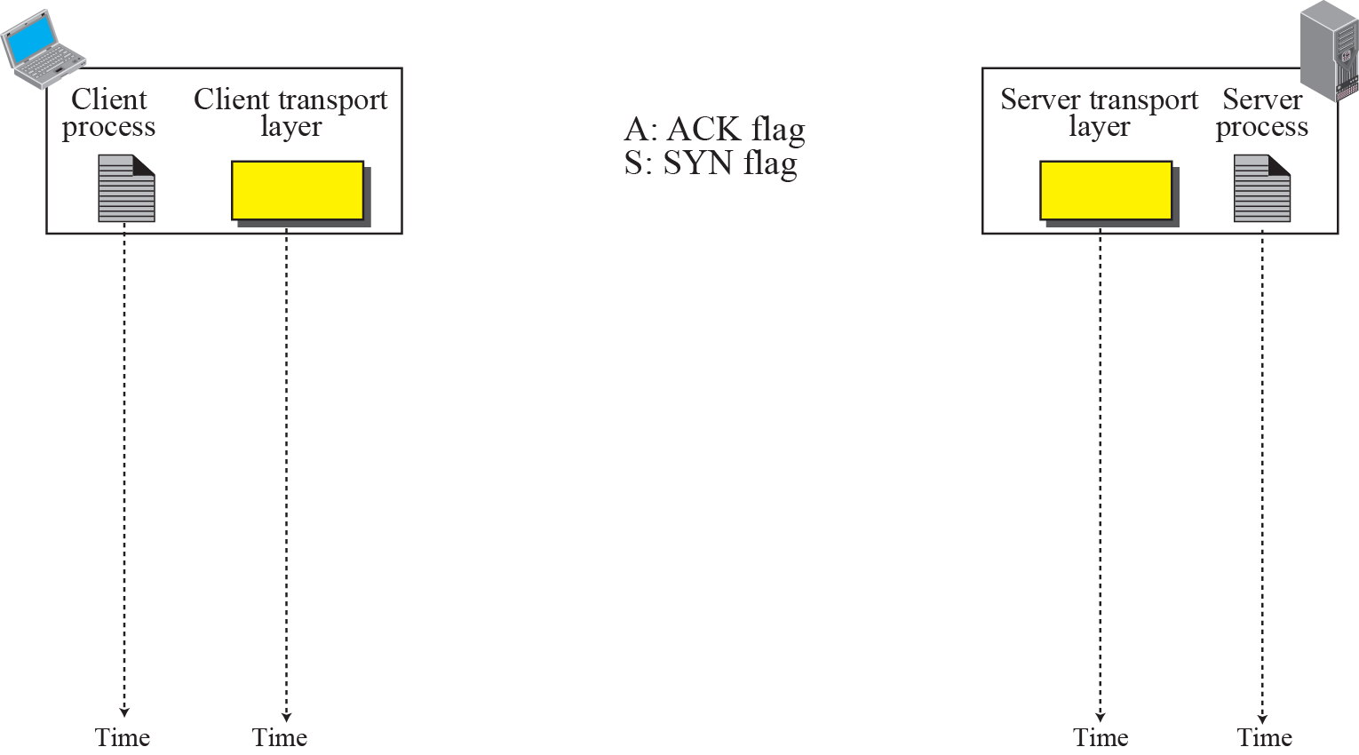

Three-way Handshaking
8001
The McGraw-Hill Companies, Inc., 2000

Slide 48
Three-way handshaking (Cont.)
The client sends the third segment, ACK segment
Acknowledge the receipt of second segment
ACK flag is set
Acknowledgement number = server initialization sequence number + 1
Must also define the window size
Set the window size field
The sequence number is the one in the SYN segment + 1
However, in some implementation, data can be sent with the third packet
Must have a new sequence number showing the byte number of the first byte in the data

Slide 49

Note
A SYN segment cannot carry data, but it consumes one sequence number.
A SYN + ACK segment cannot carry data, but does consume one sequence number.
An ACK segment, if carrying no data, consumes no sequence number.

Slide 50
Connection Establishment (Cont.)
Active open
The side that sends the first SYN
Passive open
The side that receives this SYN and sends the next SYN
Simultaneous open
Both processes issue an active open
Improbable occur
But only a single connection is established.

Slide 51
SYN Flooding Attack
A malicious attacker sends a larger number of SYN segment to a server
Each with a fading source IP address
The server will runs out of resource and may crash
Denial of service attack

Slide 52
SYN Flooding Attack (Cont.)
Possible solutions
Impose a limit of connections requested during a period of time
Filter out datagrams coming from unwanted source addresses
Postpone resource allocation until the entire connection is set up
SCTP uses strategy, called cookie
P.73 in Chapter 16

Slide 53
Data Transfer
Bidirectional data transfer takes place after connection is established
Both parties can send data and acknowledgments in both direction
Piggyback acknowledgment when sending a data segment

Slide 54
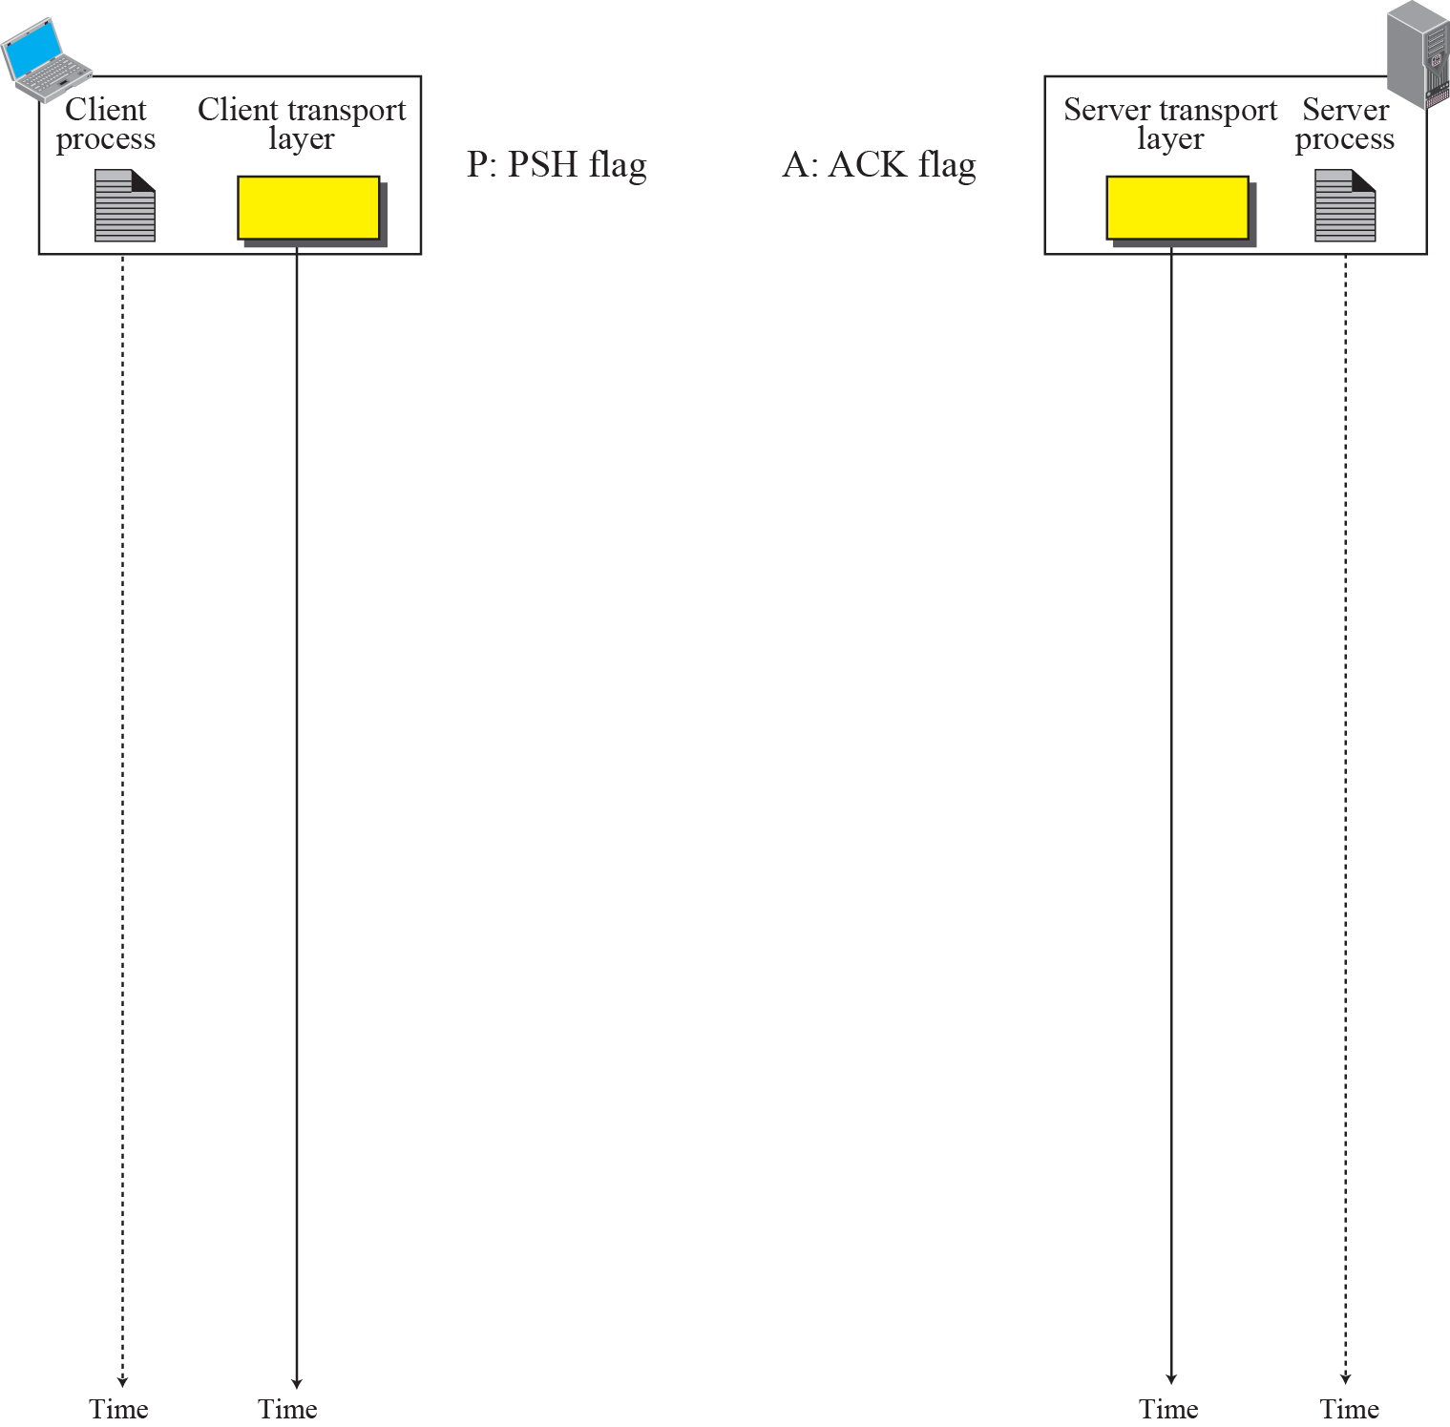
10001

Slide 55
Pushing Data
In TCP, both sender and receiver have buffers to hold data
In sender, application data to be sent is temporary hold in the buffer
In receiver, receiving data is temporary hold in the buffer
Thus, for applications, they may encounter delayed transmission and reception

Slide 56
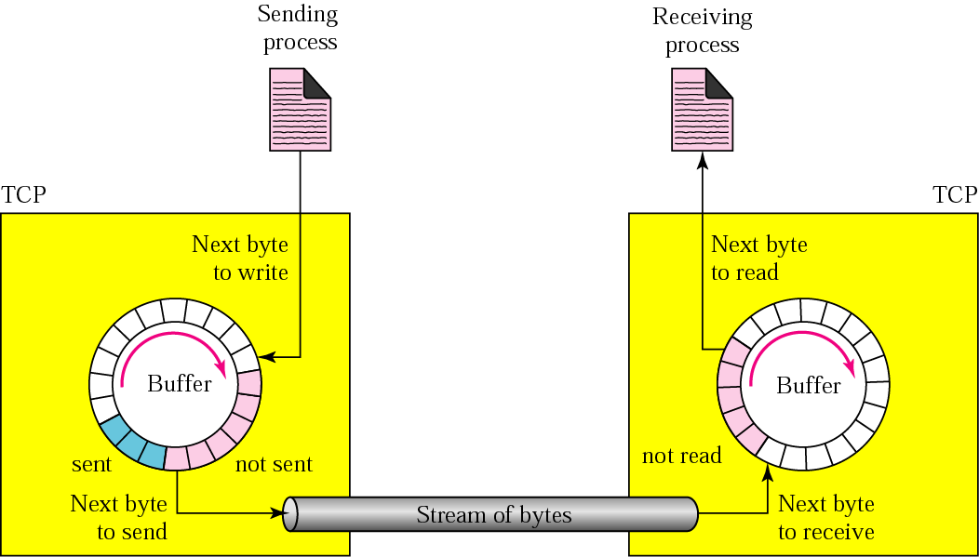
Figure 12-5
Sending and Receiving Buffers
The McGraw-Hill Companies, Inc., 2000

Slide 57
Pushing Data (Cont.)
In some cases, delayed transmission and reception may not be acceptable
TCP thus support PUSH operation
Sending TCP must create a segment and send the data immediately
Must not wait for the window to be filled
Receiving TCP must deliver data to the application immediately
Does not wait for more data to come

Slide 58
Urgent Data
TCP is a stream-oriented protocol
Data is presented as a stream of bytes
In some cases, an application needs to send urgent data
Sender wants a piece of data to be read out of order by the receiving application

Slide 59
Urgent Data (Cont.)
Solution: send a segment with URG bit set
Sender creates a segment
Insert the urgent data at the beginning of the segment
The urgent pointer field defines the end of the urgent data and the start of normal data
Send the segment with the URG bit set

Slide 60
Connection Termination
Two options
Three-way handshaking
Four-way handshaking with a half-close option
By calling shutdown() with a second argument of 1
Instead of calling close()

Slide 61
Three-Way Handshaking
Client TCP sends the FIN segment
FIN flag is set
Two choices
FIN segment is only a control segment
Consume only one sequence number
FIN segment can include the last chunk of data sent by the client

Slide 62
Three-Way Handshaking (Cont.)
The server TCP sends the FIN+ACK segment
ACK bit is set
Confirm the receipt of FIN segment
FIN bit is set
Announce the closing of the connection in the other direction
Two choices
FIN+ACK segment is only a control segment
Consume only one sequence number
FIN +ACK segment can include the last chunk of data sent by the server

Slide 63
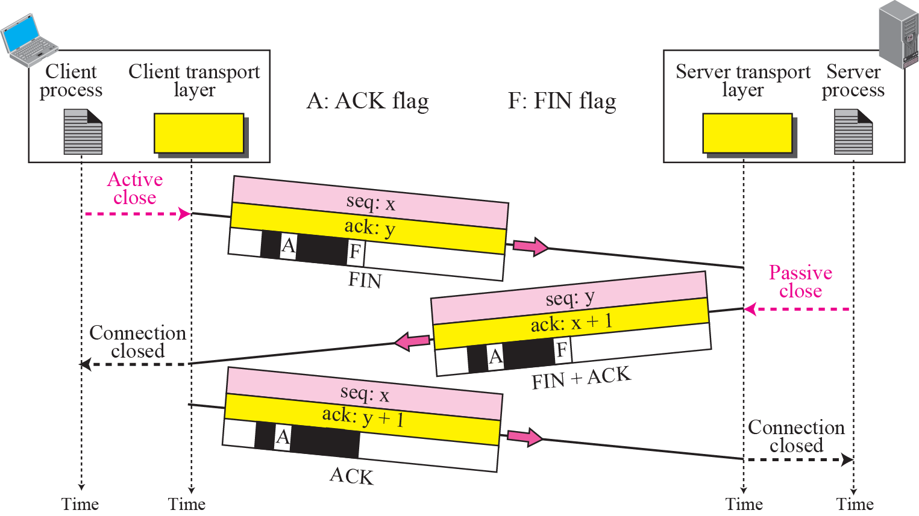
Three-Way Handshaking
x+1
The McGraw-Hill Companies, Inc., 2000

Slide 64
Three-Way Handshaking (Cont.)
3. Client TCP sends the last ACK segment
ACK bit is set
Confirm the receipt of the FIN+ACK segment for the TCP server
This segment cannot carry data and consume no sequence number
No further response!

Slide 65
Four-Way Handshaking with Half-Close
Host A sends a FIN segment announcing its wish for connection termination
Host B sends a ACK segment acknowledging the FIN segment from A
The connection is closed in one direction
But host B can continue sending data to A
Host B sends a FIN segment to close the connection
Host A sends a ACK segment to acknowledges the FIN segment from B

Slide 66
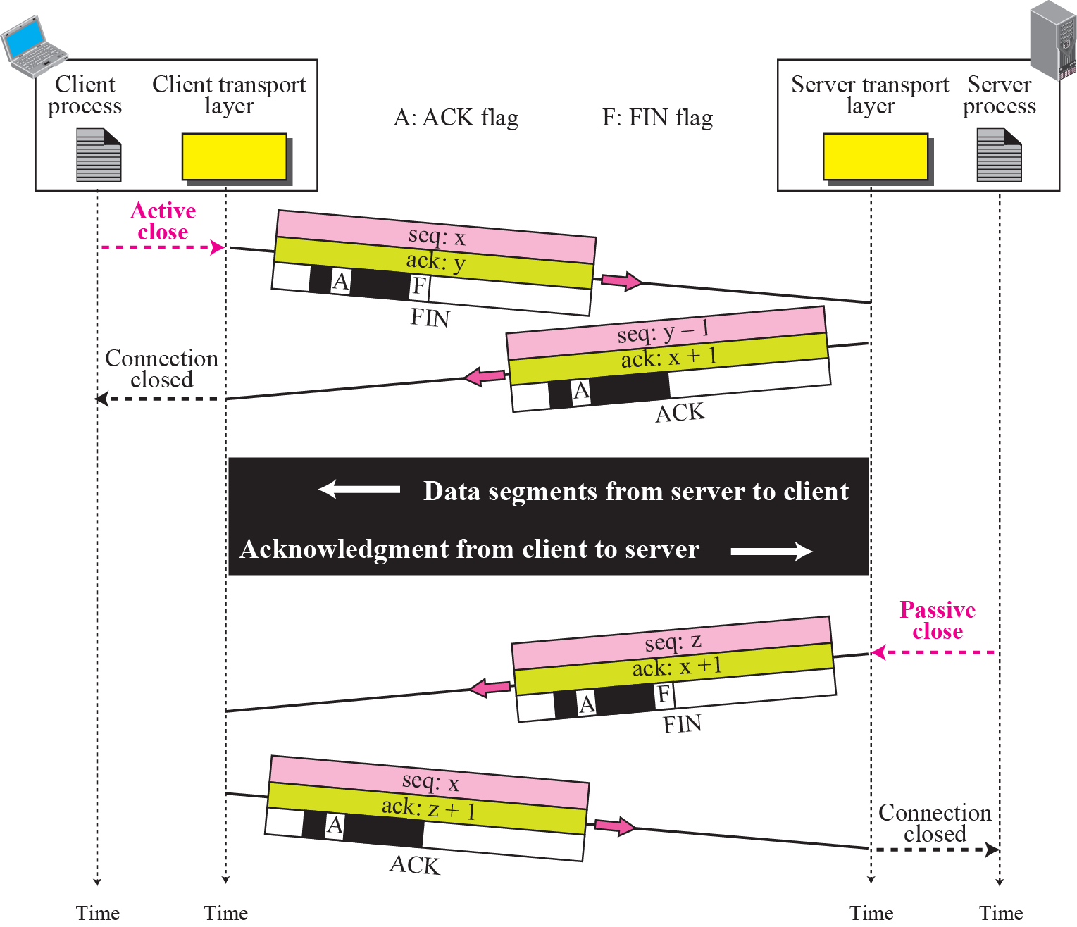
Half-Close
y
x+1
x+1
z+1

Slide 67
Connection Reset
The TCP at one end may
Deny a connection request
Abort a connection
Terminate an idle connection
How to achieve ?
By the RST (reset) flag

Slide 68
Denying a Connection
Example
A TCP segment is received and requested a connection to a nonexistent port
The receiving TCP sends a segment with the RST bit set

Slide 69
Aborting a Connection
A process may want to abort a connection instead of closing it normally
Example, the process does not want the data in the queue to be sent
If closed normally, the data will be sent

Slide 70
Terminate an Idle Connection
TCP on one side may discover that the TCP on the other side has been idle for a long time
Send an RST segment to destroy the connection

Slide 71
Outline
TCP Services
TCP Features
Segment
A TCP Connection
State Transition Diagram (Skip!)
Windows in TCP
Flow Control
Error Control
Congestion Control
TCP Timers
Options
TCP Package

Slide 72
12.5 STATE TRANSITION DIAGRAM
To keep track of all the different events happening during connection establishment, connection termination, and data transfer, the TCP software is implemented as a finite state machine. .
The topics discussed in this section include:
Scenarios

Slide 73
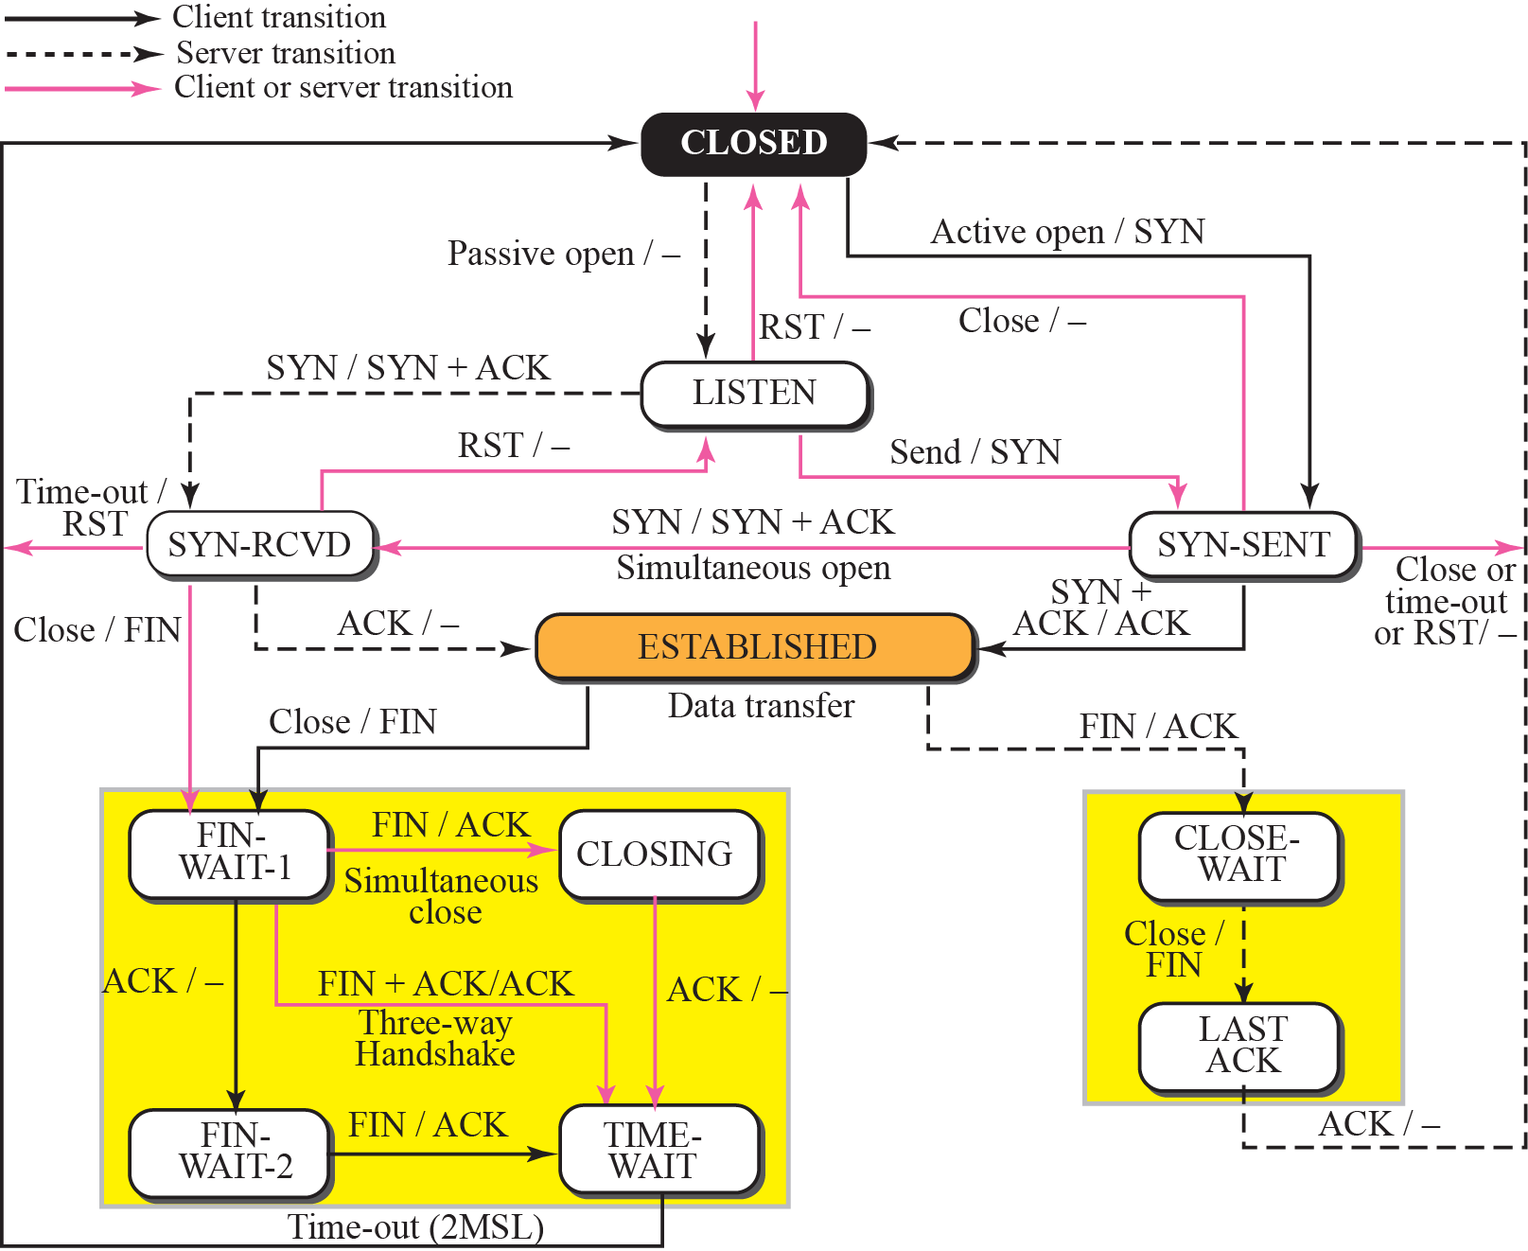
Figure 12-30
State Transition Diagram
The McGraw-Hill Companies, Inc., 2000

Slide 74
Outline
TCP Services
TCP Features
Segment
A TCP Connection
State Transition Diagram
Windows in TCP
Flow Control
Error Control
Congestion Control
TCP Timers
Options
TCP Package

Slide 75
Windows in TCP
TCP uses two windows for each direction
Send window
Receive window
Thus, four windows for a bidirectional communication in TCP
The windows in TCP number bytes

Slide 76
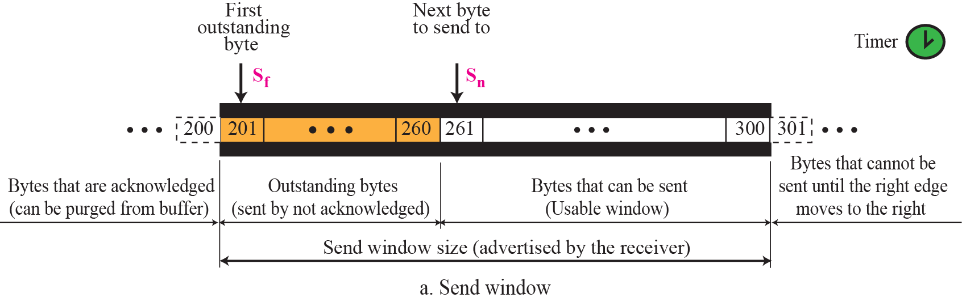
Send Window

Slide 77
Figure 12-5
Sending and Receiving Buffers
The McGraw-Hill Companies, Inc., 2000

Slide 78
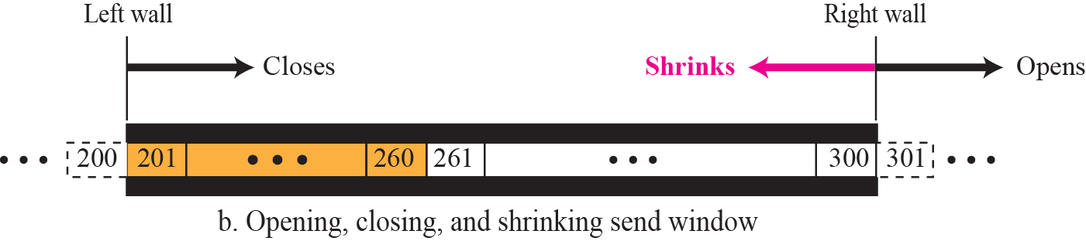
Send Window (Cont.)
A send window can open, close, or shrink
Detailed are introduced later

Slide 79
Receive Window
The receive window size, rwnd is calculated as:
As shown in the figure (a) of the next slide
A receive can open and close
It should never shrink
As shown in the next slide
Open: moves its right wall to the right
When more bytes are pulled by the process
Close: moves its left wall to the right
When more bytes arrive from the sender
rwnd = buffer size – number of waiting bytes to be pulled

Slide 80
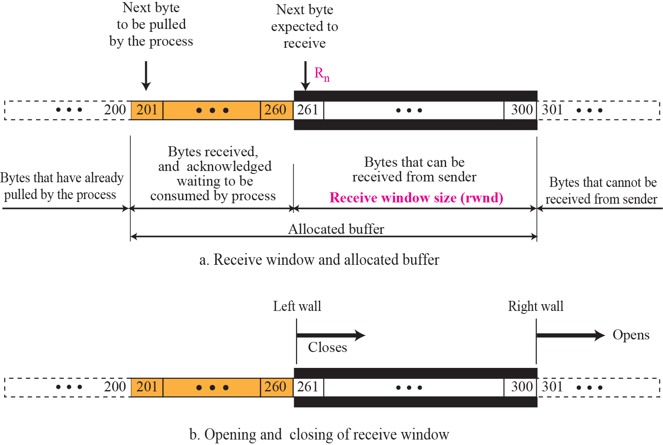

Slide 81
Outline
TCP Services
TCP Features
Segment
A TCP Connection
State Transition Diagram
Windows in TCP
Flow Control
Error Control
Congestion Control
TCP Timers
Options
TCP Package

Slide 82
12.6 FLOW CONTROL
Flow control regulates the amount of data a source can send before receiving an acknowledgment from the destination. TCP defines a window that is imposed on the buffer of data delivered from the application program.
The topics discussed in this section include:
Sliding Window Protocol
Silly Window Syndrome

Slide 83
Flow Control
Balance the rate a producer creates data with the rate a consumer can use the data
Solution: the sliding window protocol by TCP
Both hosts use a window for each connection
Called sliding windows
The window can slide over the buffer
TCP’s sliding windows are byte oriented

Slide 84
Figure 12-5
Sending and Receiving Buffers
The McGraw-Hill Companies, Inc., 2000

Slide 85
Sliding Window Protocol (Cont.)
The window is opened, closed, or shrunk
Opening a window
Moving the right wall to the right
Closing a window
Moving the left wall to the right
Shrinking the window
Moving the right wall to the left

Slide 86
Sliding Window Protocol (Cont.)
The size of the window at one end is determined by the minimum of two values
Receiver window (rwnd)
Advertised by the opposite end in a segment containing acknowledgement
Congestion window (cwnd)
Determined by the network to avoid congestion
Discussed later

Slide 87
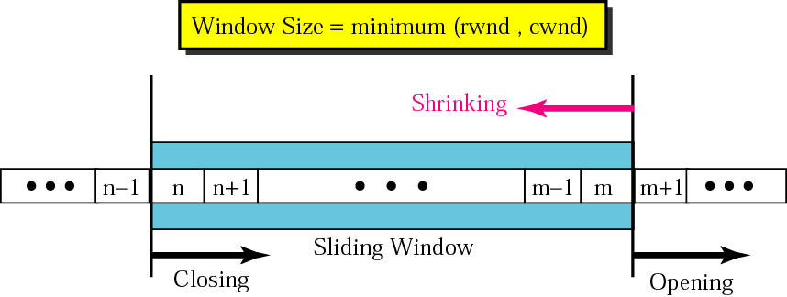
Figure 12-11
Sliding Window in the Sending TCP
data has been sent and acked
IP
The McGraw-Hill Companies, Inc., 2000

Slide 88
Example A
Suppose that Receiver B:
Buffer size = 5000
Receive 1000 bytes unprocessed data
What is the value of the receiver window (rwnd) for sender A?
Solution
The value of rwnd = 5,000 − 1,000 = 4,000.
Host B can receive only 4,000 bytes of data before overflowing its buffer.
Host B advertises this value in its next segment to A.

Slide 89
Example B
Suppose sender A:
rwnd = 3000 bytes
cwnd = 3500 bytes
What is the size of the window for host A?
Solution
The size of the window is the smaller of rwnd and cwnd
Ans: 3,000 bytes

Slide 90
Example C: Figure 12.21 shows an unrealistic example of a sliding window
The sender has sent bytes up to 202.
cwnd = 20 (in reality this value is thousands of bytes).
The receiver has sent a ACK segment
Acknowledgment number = 200
rwnd = 9 bytes (in reality this value is thousands of bytes).
Therefore
The size of the sender window
The minimum of rwnd and cwnd or 9 bytes.
Bytes 200 to 202 are sent, but not acknowledged.
Bytes 203 to 208 can be sent without worrying about acknowledgment.
Bytes 209 and above cannot be sent.

Slide 91
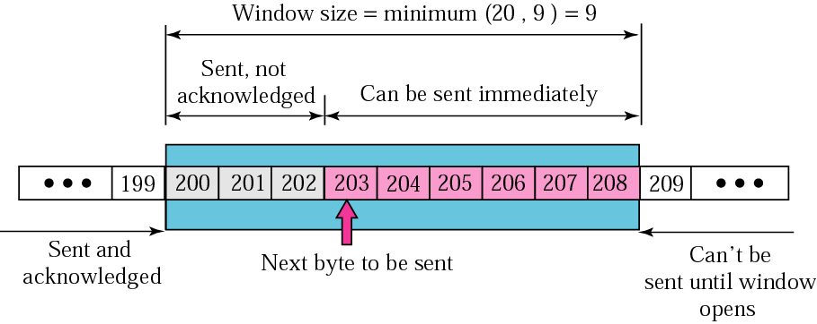
Figure 12-11
Figure 12.21
The McGraw-Hill Companies, Inc., 2000

Slide 92
Example D
In Figure 12.21
Server receives a packet
Acknowledgment value = 202
rwnd = 9.
The host has already sent bytes 203, 204, and 205.
The value of cwnd is still 20.
Show the new window.

Slide 93
Example D (Cont.)
Solution
Figure 12.22 shows the new window.
Note that this is a case in which the window
Closes from the left and opens from the right by an equal number of bytes
The size of the window has not been changed.
The acknowledgment value, 202, declares that bytes 200 and 201 have been received

Slide 94
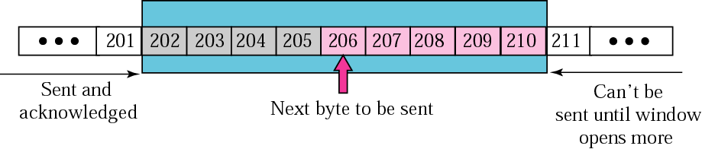
Figure 12-11
Figure 12.22
The McGraw-Hill Companies, Inc., 2000

Slide 95
Example E
In Figure 12.22
Sender receives a packet
Acknowledgment value = 206
rwnd = 12.
The host has not sent any new bytes.
The value of cwnd is still 20.
Show the new window.

Slide 96
Example E (Cont.)
Solution
rwnd < cwnd
The size of the window is 12.
Figure 12.23 shows the new window.
The window has been opened from the right by 7 and closed from the left by 4
The size of the window has increased.

Slide 97
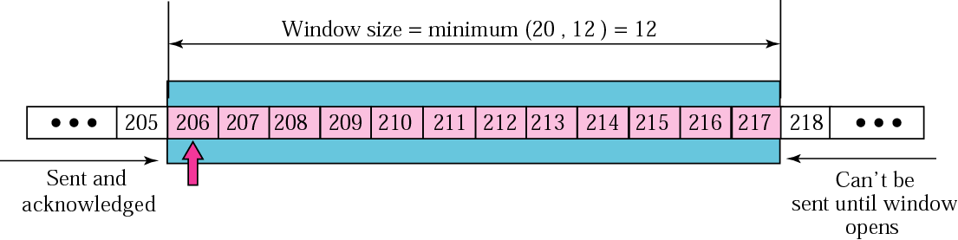
Figure 12-11
Figure 12.23
The McGraw-Hill Companies, Inc., 2000

Slide 98
A Scenario: An example of flow control (As Shown in the Next Figure)
1. SYN segment
Client announces its initial seq. number = 100
When server receives, assume that the server allocates a buffer size of 800
2. ACK+SYN
The client also announces a buffer size of 800
3. ACK
4. The client process pushes 200 bytes of data
Number from 101 to 300 and send this segment
5. Send ACK from server to client
6. The client process again push 300 more bytes
A new segment: seqNo=301, length = 300 bytes
Assume that the server process also pulled 100 bytes of data
Thus, the receiver window only reduce 200 bytes
7, 8. ACK from the server to the client

Slide 99
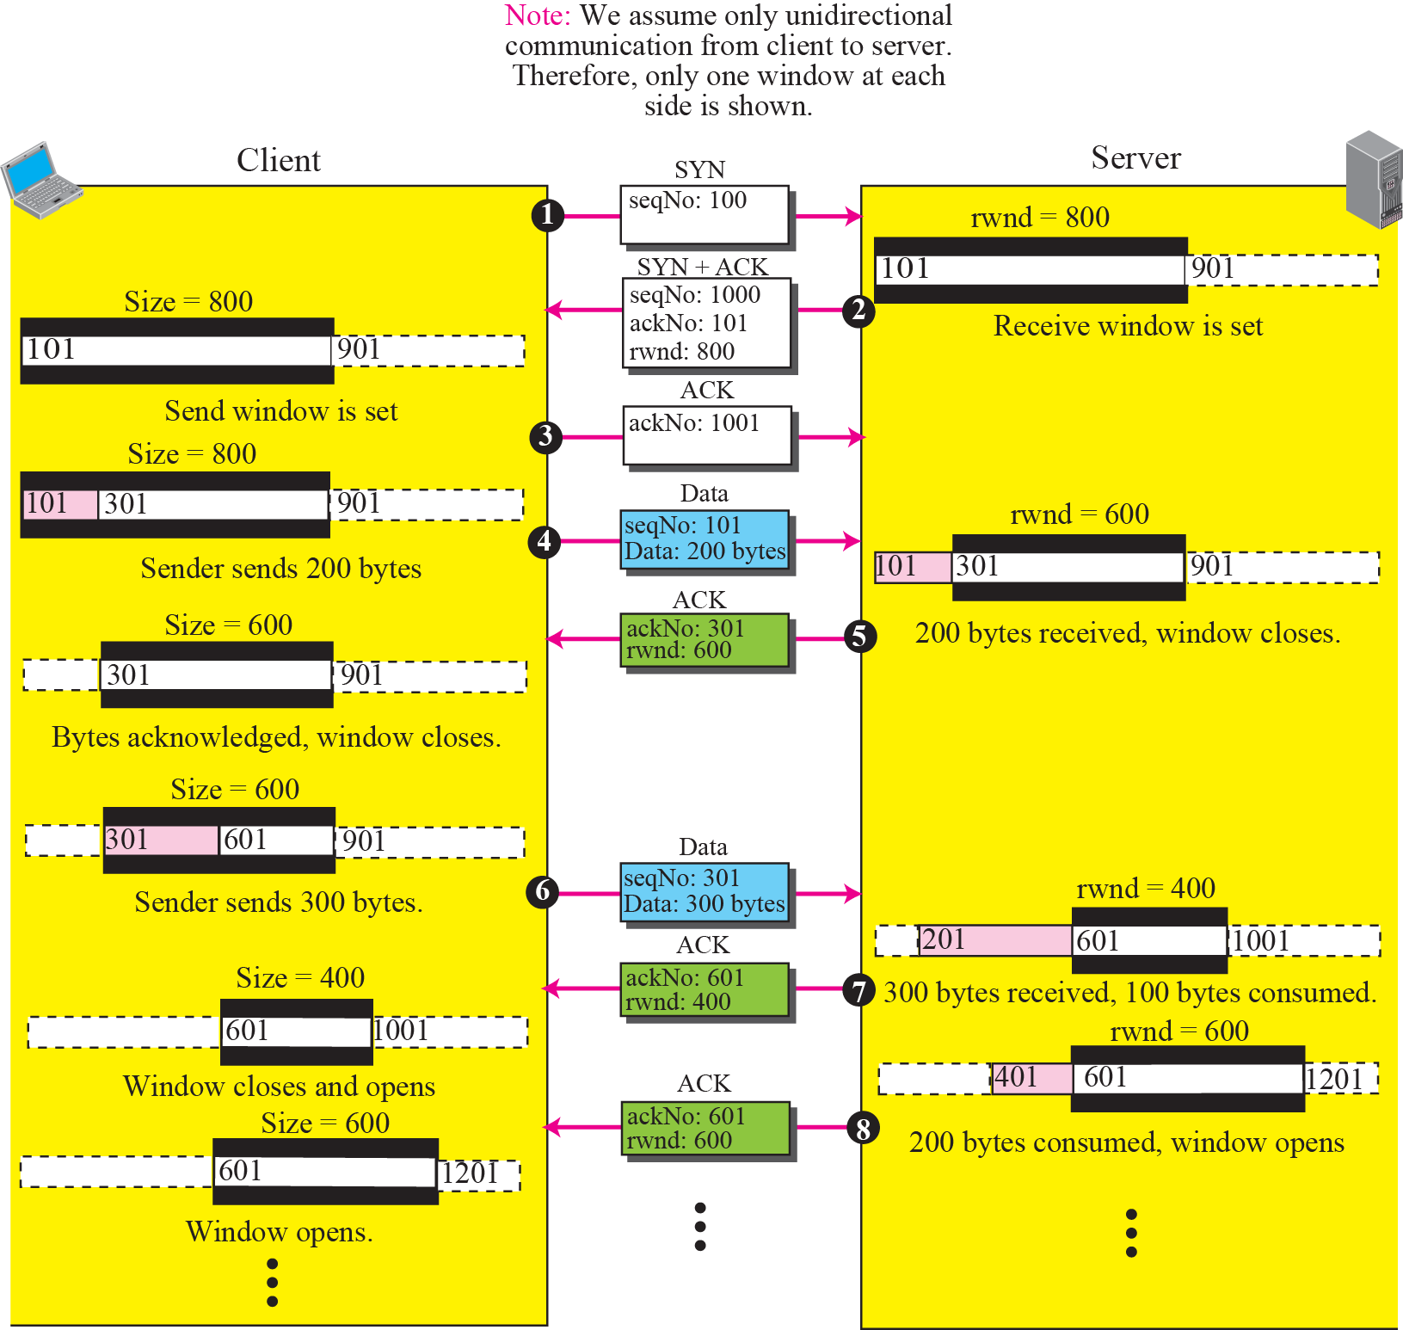

Slide 100
Shrinking of Windows
The receiver never shrink
But the sender window can shrink on occasion
If the receiver defines a value for rwnd that results in shrinking the window
Some implementations do not allow

Slide 101
Example 15.2
Figure 15.26 shows the reason in window shrinking.
Part a shows values of last acknowledgment and rwnd.
Part b shows the situation in which the sender has sent bytes 206 to 214. Bytes 206 to 209 are acknowledged and purged.
The new advertisement, however, defines the new value of rwnd as 4, in which 210 + 4 < 206 + 12.
When the send window shrinks, it creates a problem: byte 214 which has been already sent is outside the window.
Solution:
Let the receiver postpone its feedback until enough buffer locations are available in its window.
In other words, the receiver should wait until more bytes are consumed by its process.

Slide 102
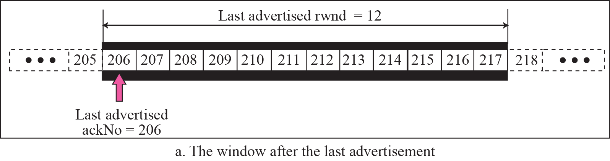
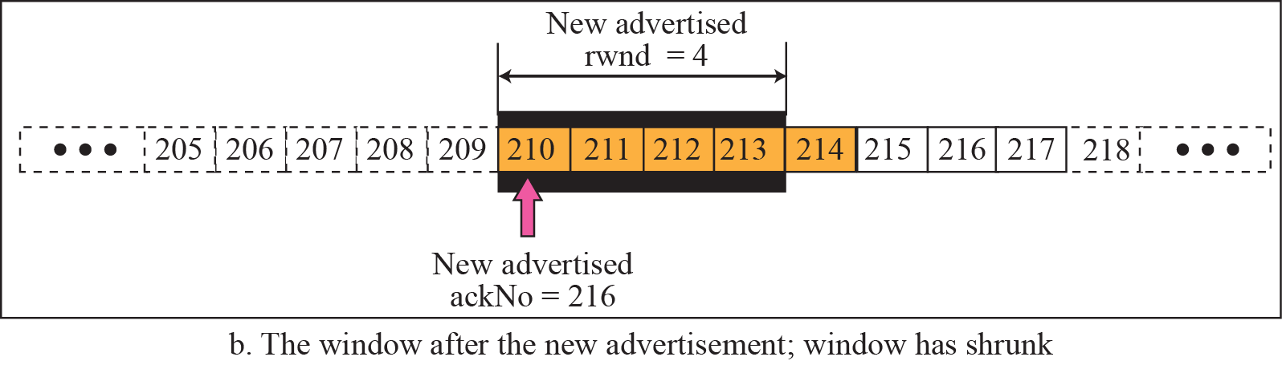
210

Slide 103
Solution of Shrinking the Window
How can the receiver avoid shrinking the window in the example 15.2?

Slide 104
Example 9 (Cont.)
Solution:
The receiver needs to keep track of the last acknowledgment number and the last rwnd.
Right wall = acknowledgment number + rwnd
To prevent shrinking, we must always have the following relationship.
new ack + new rwnd ≥ last ack + last rwnd or new rwnd ≥ (last ack + last rwnd) − new ack

Slide 105
Example 9 (Cont.)
In example 8
New Ack. Num. = 216, New rwnd = 4
Last Ack. Num = 206, Last rwnd = 12
210+4 < 206+12; the relationship is not hold
Thus, the receiver must want until more buffer space is free before sending an ack.
i.e., have a larger value of rwnd

Slide 106
Window Shutdown
In some cases, the receiver does not want to receive any data from the sender for a while
The receiver temporarily shut down the window
Sending a segment with the rwnd = 0
The sender stops until a new advertisement has arrived
However, during window shutdown
The sender can always send a segment with one byte of data
Called probing and is used to prevent deadlock

Slide 107

Some Points about TCP’s Sliding Windows
The size of the window is the lesser of rwnd and cwnd
The source does not have to send a full window’s worth of data
The send window can be opened or closed by the receiver, but should not be shrunk
The destination can send an acknowledgment at any time as long as it does not result in a shrinking window
The receiver can temporarily shut down the window; the sender, however, can always send a segment of one byte after the window is shut down

Slide 108
Silly Window Syndrome
Problem in the sliding window operation
The sending process creates data slowly
Or the receiving process consume data slowly
Or both
Result in the sending of data in very small segment
Reduce the network efficiency
For example, send a one byte segment result in overhead of 41/1
Assume TCP header is 20 bytes + IP header is 20 bytes

Slide 109
Syndrome Created by the Sender
Sender application create data too slowly
For example, only 1 byte at a time
Sending TCP would create segments containing 1 byte of data
Solution: prevent the sending TCP from sending the data byte by byte
Sending TCP must be forced to wait as it collects data to send in a larger block
But, how long should the sending TCP wait?

Slide 110
Nagle’s Algorithm
Nagle found the solution to above syndrome
The sending TCP sends the first piece of data it receives from the sending application
Even if it is only 1 byte
After sending the first segment, the sending TCP accumulates data in the buffer and wait until
Either the receiving TCP sends an acknowledge
Or until enough data has accumulated to fill a maximum-sized segment
Step 2 is repeated. Segment 3 is sent if an acknowledgment is received for segment 2 or enough data is accumulated to fill a maximum-size segment

Slide 111
Nagle’s Algorithm (Cont.)
Elegance
Very simple
Take into account the speed of the application that creates the data and the speed of the network that transports the data
If application is faster than the network
The segments are larger
If the application is slower than the network
The segment are smaller

Slide 112
Syndrome Created by the Receiver
The receiving TCP may also create a silly window syndrome
If it is serving an application that consumes data slowly
For example
Sender application create data in 1K byte blocks
But the receiving application consumes data 1 byte at a time
Assume the receiver buffer is 4K bytes
Buffer will be full soon
Sender then only can send 1 byte data to the receiver

Slide 113
Syndrome Created by the Receiver (Cont.)
Solution
Clark’s solution
Delayed acknowledgment

Slide 114
Clark’s Solution
Send an acknowledgment as soon as the data arrives but to announce a window size of zero until
Either there is enough space to accommodate a segment of maximum size
Or half of the buffer is empty

Slide 115
Delayed Acknowledgment
Delay sending the acknowledgment
When a segment arrives, it is not acknowledged immediately
Receiver waits until there is a decent amount of space in its incoming buffer
Delayed acknowledgment prevents the sending TCP from sliding it window

Slide 116
Delayed Acknowledgment (Cont.)
Another advantage
Reduce traffic
The receiver does not have to acknowledge each segment
Disadvantage
The sender may retransmit the unacknowledged segment
Solution
Defines the acknowledgment should not be delayed by more than 500 ms

Slide 117
Outline
TCP Services
TCP Features
Segment
A TCP Connection
State Transition Diagram
Windows in TCP
Flow Control
Error Control
Congestion Control
TCP Timers
Options
TCP Package

Slide 118
12.7 ERROR CONTROL
TCP provides reliability using error control, which detects corrupted, lost, out-of-order, and duplicated segments. Error control in TCP is achieved through the use of the checksum, acknowledgment, and time-out.
The topics discussed in this section include:
Checksum
Acknowledgment
Retransmission
Out-of-Order Segments
Some Scenarios

Slide 119
Error Control
TCP provides reliability using error control
Detect corrupted segment, lost segment, out-of-order segment, and duplicated segment
Error detection and correction is achieved by
Checksum
Acknowledgment
Time-out

Slide 120
Checksum
TCP uses 16-bit checksum
Mandatory in every segment
Actually, 16-bit checksum is considered inadequate for SCTP
Mentioned later

Slide 121
Acknowledgment
TCP uses acknowledgment to confirm the receipt of data segment
Control segments that carry no data but consume a sequence number are also acknowledged
ACK segment are never acknowledged

Slide 122
Acknowledgment Type
Acknowledgment type
Accumulative Acknowledgment (ACK)
In past, TCP only uses this ACK
Selective Acknowledgment (SACK)
Newly added feature

Slide 123
Accumulative Acknowledgment (ACK)
The receiver advertises the next byte it expects to receive
Ignore all segments received out-of-order
Also called “positive” accumulative acknowledgement
Discarded, lost, or duplicated segments are not reported

Slide 124
Selective Acknowledgment (SACK)
Does not replace ACK
But report additional information to the sender
The block of data that is out-of-order
The block of segments that is duplicated
SACK is implemented as an option
Since there is no provision in the TCP header for SACK

Slide 125
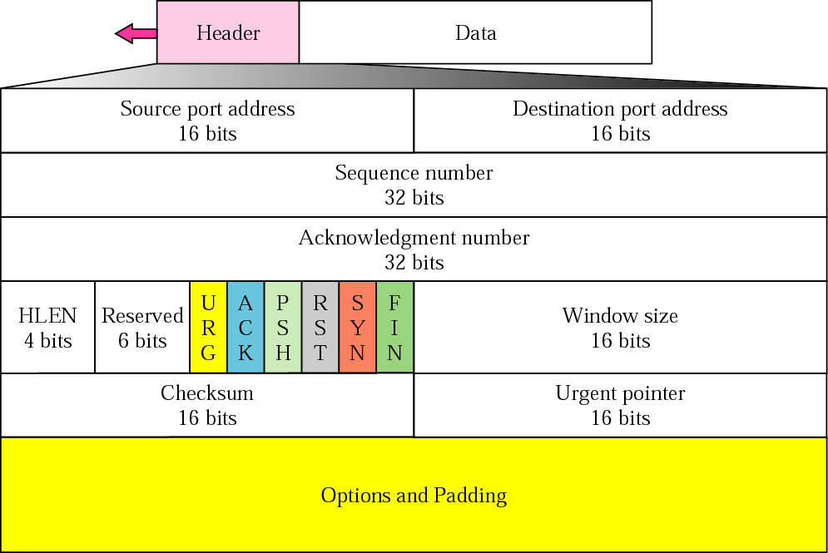
Figure 12-19
TCP Segment Format
The McGraw-Hill Companies, Inc., 2000

Slide 126
Generating Acknowledgments: When Does a Receiver Generate Acknowledgment?
When one end sends a data segment
It must piggyback an acknowledgment
Decrease the number of segments needed
The receiver delays sending an ACK
When the following three conditions hold
When the receiver has no data to send
It receives an in-order segment
The previous segment has already been acknowledged
The receiver delays sending an ACK
until another segment arrives or
Until a period of time (normally 500 ms) has passed
Thus, if only one outstanding in-order segment
Delaying sending an ACK
Prevent ACK segments from creating extra traffic

Slide 127
Generating Acknowledgments: When Does a Receiver Generate Acknowledgment? (Cont.)
The receiver immediately sends an ACK
When the following two conditions hold
An in-order segment arrives
The previous in-order segment has not been acknowledged
Thus, there should not be more than two in-order unacknowledged segment at any time
Prevent unnecessary retransmission

Slide 128
Generating Acknowledgments: When Does a Receiver Generate Acknowledgment? (Cont.)
The receiver immediately sends an ACK
When an out-of-order segment with higher sequence number is received
Enable fast retransmission of any missing segment
When a missing segment arrives, the receiver sends an ACK
Inform the sender that segments reported missing have been received
The receiver immediately sends an ACK if a duplicate segment arrives
Solve some problems when an ACK segment itself is lost

Slide 129
Retransmission
When to retransmit a segment
When a retransmission timer expires: TCP Tahoe
When the sender receives three duplicate ACK: TCP Reno
No retransmission occurs for segments
If it does not consume sequence number
If it is an ACK segment

Slide 130
Retransmission After RTO
Sender TCP starts a retransmission time-out (RTO) timer for each segment sent
If timer matures
Retransmit the segment
RTO value is dynamic
Updated based on the round trip time (RTT)

Slide 131
Retransmission After Three Duplicated ACK Segments
A segment is lost but the receiver receives so many out-of-order segments
Buffer may overflow
Solution: fast retransmission
Retransmit the missing segment immediately if three duplicate ACK received

Slide 132
Out-of-Order Segment
Out-of-order
When a segment is delayed, lost, or discarded
Previous solution in TCP
Does not acknowledge an out-of-order segment
Discard all out-of-order segment
Result in the retransmission of the missing segment and the following segment

Slide 133
Out-of-Order Segment (Cont.)
Current implementation of TCP
Store out-of-order segments temporarily
Until the missing segment arrives
Note
The out-of-order segment are not delivered to the process
TCP guarantees in-order delivery

Slide 134
Note
Data may arrive out of order and be temporarily stored by the receiving TCP,
but TCP guarantees that no out-of-order data are delivered to the process.

Slide 135
Some Scenarios
Some scenarios occurs during the operation of TCP
Normal operation
Lost segment
Fast retransmission
Delayed segment
Duplicate segment
Automatically corrected lost ACK
Lost acknowledgment corrected by resending a segment
Deadlock created by lost acknowledgment

Slide 136
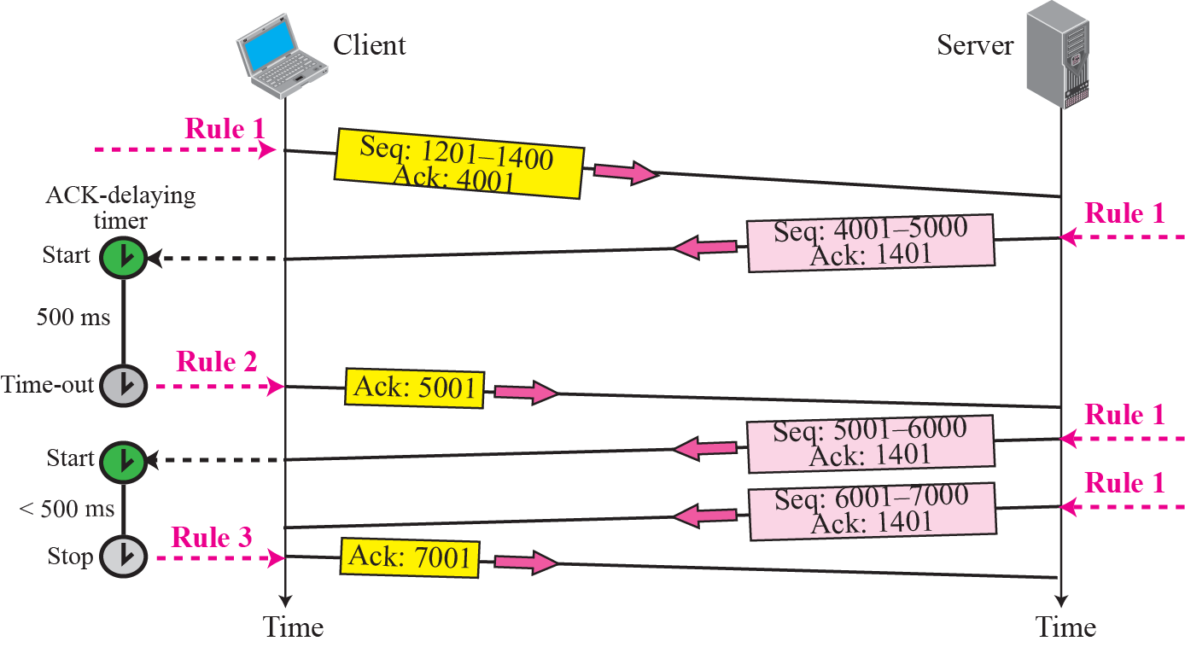
Figure 12-13
Normal Operation
Wait to see if more segments arrives
The McGraw-Hill Companies, Inc., 2000

Slide 137
Lost or Corrupted Segment
A lost or corrupted segment is treated the same way by the receiver TCP
Lost segment: discarded somewhere in the network
Corrupted segment: discarded by the receiver itself
In following feature, segment 3 is lost
Receiver receives a out-of-order segment (segment 4)
Store it temporary and leave a gap
Send an ACK immediately (ACK number = 701)
Sender resent segment 3 when the RTO timer matures

Slide 138
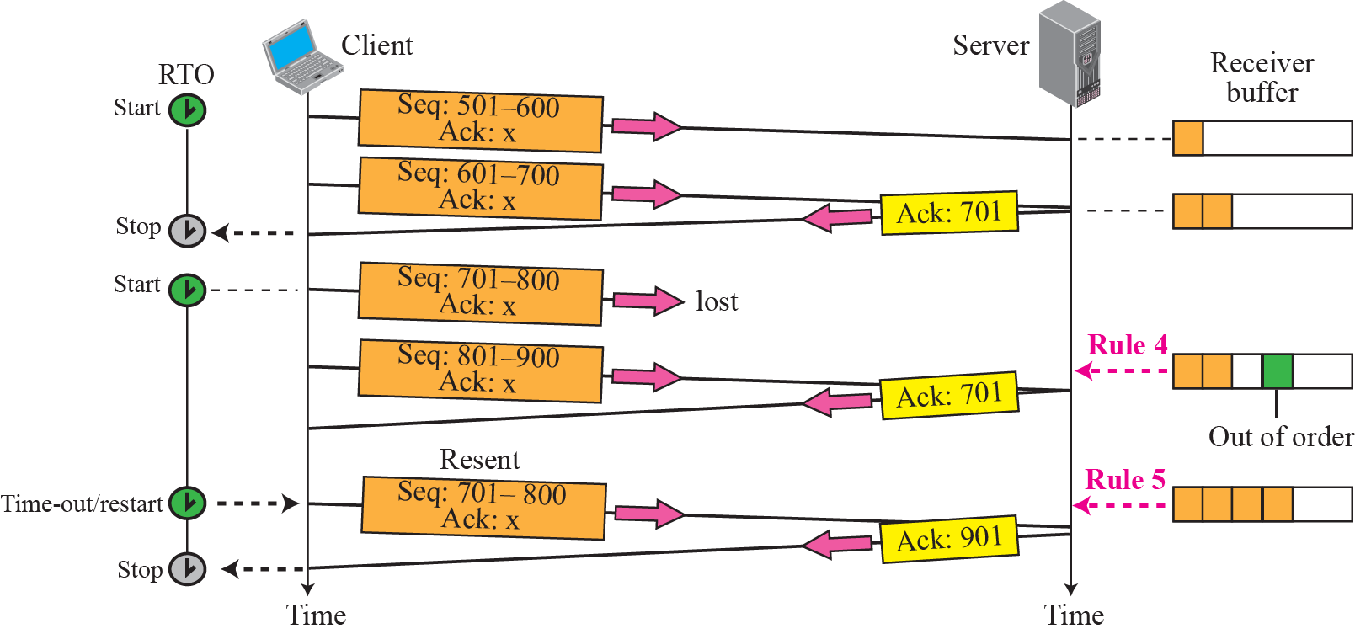
Lost Segment
Rule 3

Slide 139
Fast Retransmission
In the following feature
When the receiver receives the 4th, 5th, 6th segment, it triggers an acknowledgment
Thus, four acknowledgment are the same value
Three duplicated
Although the RTO timer for segment 3 has not yet matured
Invoke fast retransmit for segment 3

Slide 140
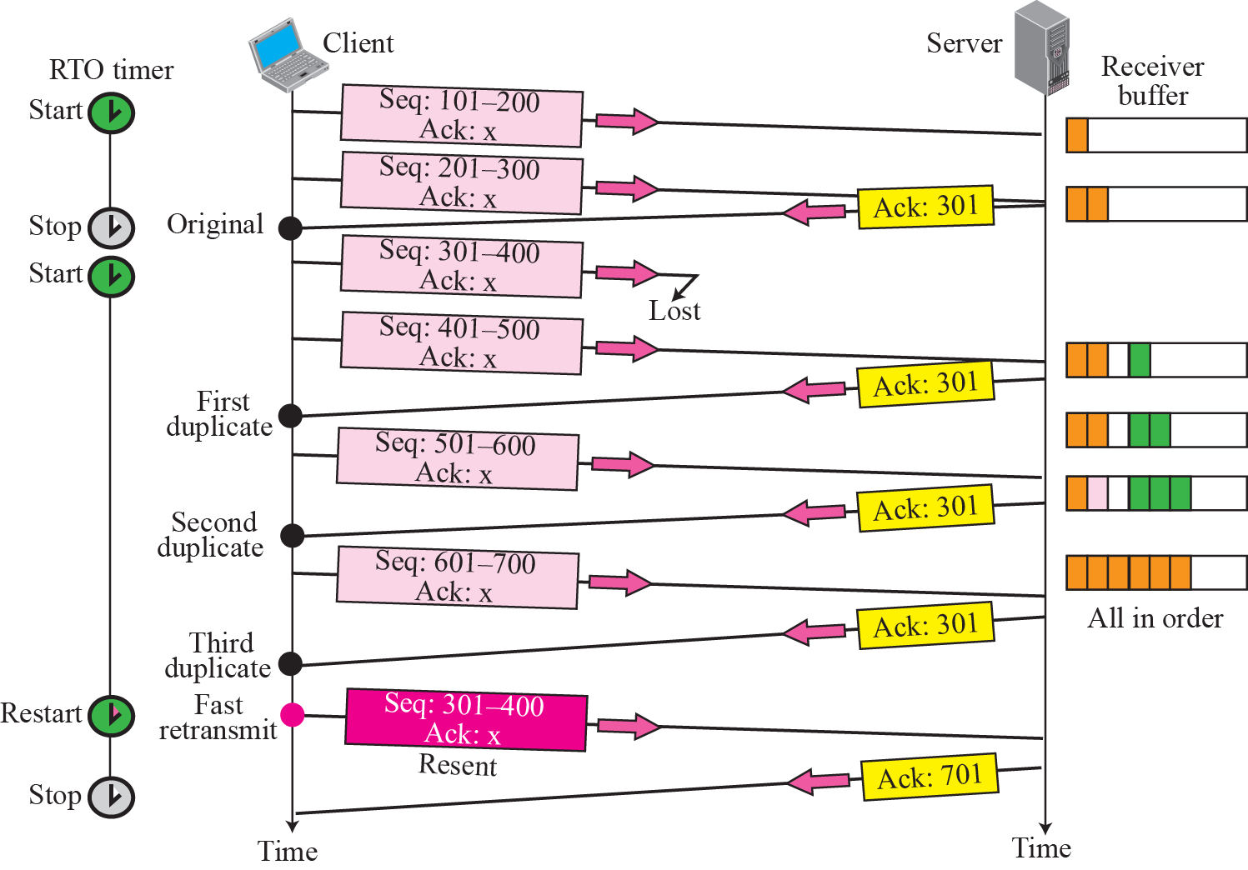
Figure 12-14
Fast Retransmission
The McGraw-Hill Companies, Inc., 2000

Slide 141
Delayed Segment
Each TCP segment is encapsulated in an IP datagram
IP datagram is routed independently
A TCP segment may be delayed
A delayed segment is treated the same way as lost or corrupted segment by the receiver
Note
A delayed segment may arrive after it has been resent
Cause a duplicate segment

Slide 142
Duplicate Segment
Created by a sending TCP when a segment is delayed and treated as lost by the receiver
Destination detects duplicate segment since they have the same sequence number
Discard the later segment

Slide 143
Automatically Corrected Lost ACK
A lost acknowledgment is automatically replaced by the next
Since ACK is accumulative
In the following feature
The next ACK automatically correct the lost of the acknowledgment

Slide 144
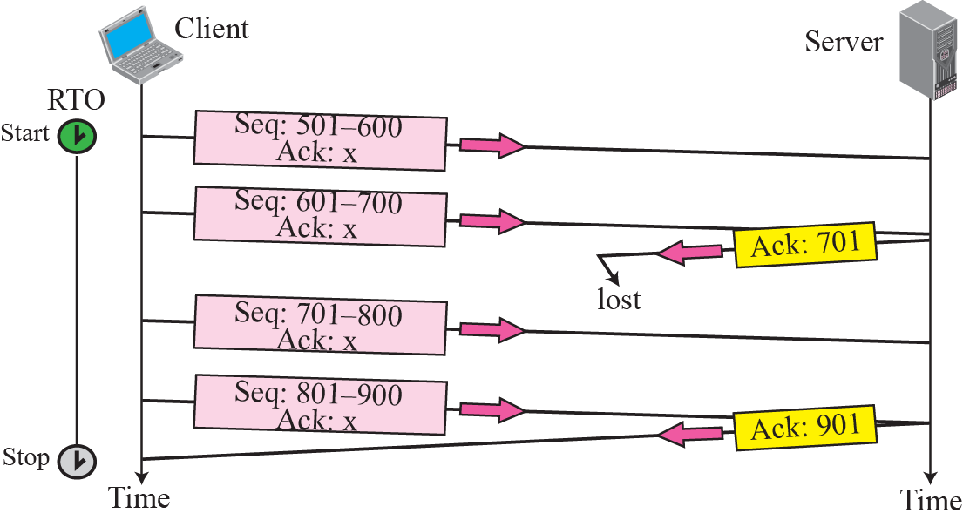
Figure 12-13
Lost Acknowledgment
The McGraw-Hill Companies, Inc., 2000

Slide 145
Lost Acknowledgment Corrected by Resending a Segment
If an ACK is lost
But the next ACK is delayed for a long time or
There is no next acknowledgment
How to correct ?
By the RTO timer and resent the data segment
Result in a duplicate ACK
Receiver just discards it
Resent the ACK immediately (rule 6)

Slide 146
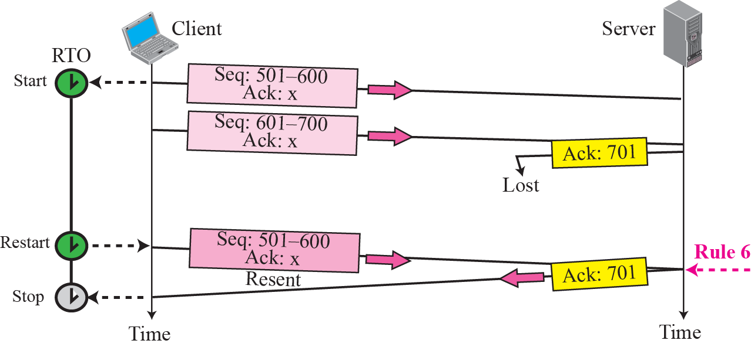
Figure 12-14
Lost Acknowledgment Corrected by Resending a Segment
The McGraw-Hill Companies, Inc., 2000

Slide 147
Deadlock Created by Lost Acknowledgment
A lose of an acknowledgment may result in system deadlock
Example
Receiver sends an ACK with rwnd = 0
Request the sender to shut down its window temporarily
The sending TCP stops transmitting segments
After a while, receiver sends an ACK and rwnd <>0
Announce it can receive data again
However, this ACK is lost
As a result, both sender and receiver continue to wait for each other forever
Solution: a persistent timer

Slide 148
Outline
TCP Services
TCP Features
Segment
A TCP Connection
State Transition Diagram
Windows in TCP
Flow Control
Error Control
Congestion Control
TCP Timers
Options
TCP Package

Slide 149
12.8 CONGESTION CONTROL
Congestion control refers to the mechanisms and techniques to keep the load below the capacity.
The topics discussed in this section include:
Congestion Window
Congestion Policy

Slide 150
Congestion Control in TCP
Outline
Congestion window
Congestion policy
Slow start: exponential increase
Congestion avoidance: additive increase
Congestion detection: multiplicative decrease

Slide 151
Congestion Window
Flow control
Sender window size is determined by the available buffer space in the receiver
However, in addition to the receiver, the network should be a second entity that determines the size of the sender’s window
Congestion control
Determine the sender window size by the congestion condition in the network

Slide 152
Congestion Window (Cont.)
Thus, the sender’s window size is determined by both
Receiver
Congestion in the network
The sender has two pieces of information
The receiver-advertised window size
The congestion window size
The actual size of the window is the minimum of these two
Actual window size
= minimum (receiver window size, congestion window size)
= minimum (rwnd, cwnd)

Slide 153
Congestion Policy
Three phase in TCP’s congestion policy
Slow start
Congestion avoidance
Congestion detection
When a congestion is detected, sender return to the slow start or congestion avoidance

Slide 154
Slow Start: Exponential Increase
At the beginning,
Congestion window size = maximum segment size (MSS)
Each time on acknowledgement arrives
Increase the congestion window size by one MSS
Until it reaches a threshold, called ssthresh (slow start threshold)
Usually, ssthresh = 65535 bytes

Slide 155
Slow Start: Exponential Increase (Cont.)
However, it is not actually “slow start”
The congestion window size increases exponentially
Start => cwnd = 1 = 2^0
After 1 RTT => cwnd = 2 = 2^1
After 2 RTT => cwnd = 4 = 2^2
After 3 RTT => cwnd = 8 = 2^3

Slide 156
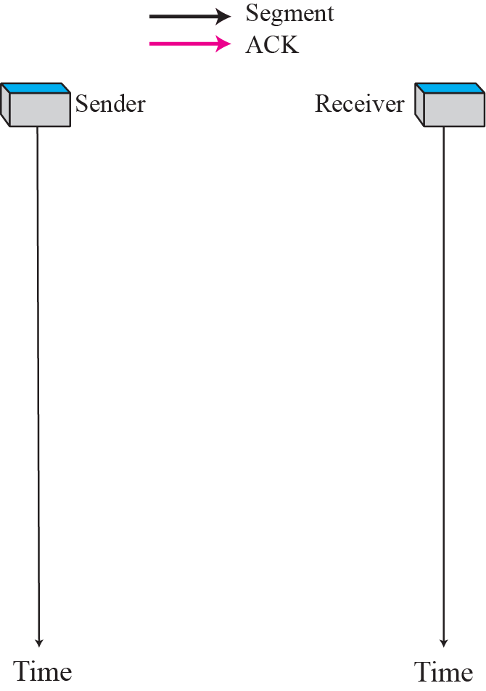
Slow Start: Exponential Increase
The McGraw-Hill Companies, Inc., 2000

Slide 157
Slow Start: Exponential Increase (Cont.)
However, slow start is slower in the case of delayed acknowledgments
Remember, for each ACK, the cwnd is increased by 1 MSS
Thus, if two segments are acknowledged accummlatively
cwnd is increased by one

Slide 158
Congestion Avoidance: Additive Increase
Started after the congestion window size reaches the ssthresh threshold
When the whole window of segments is acknowledged
The size of congestion window is increased one
Note, the whole window size is usually larger than one in congestion avoidance

Slide 159
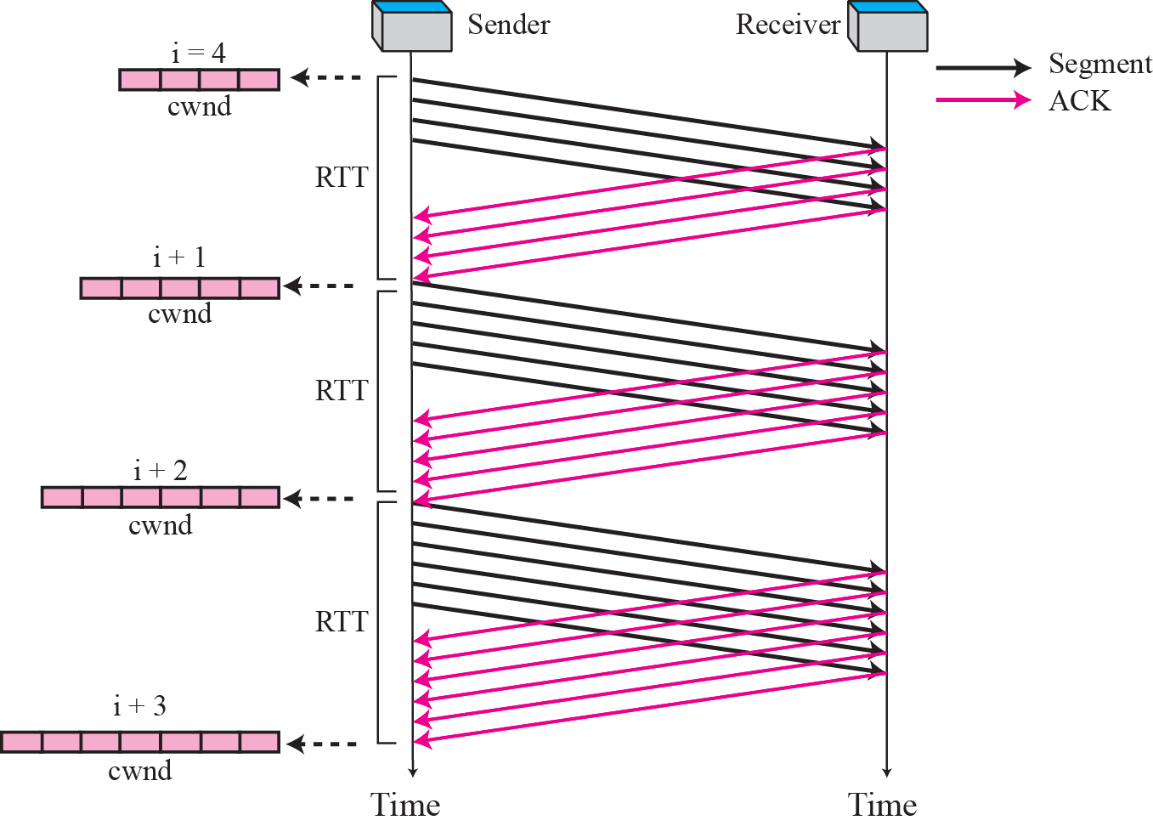
Figure 12-14
Congestion Avoidance, Additive Increase
The McGraw-Hill Companies, Inc., 2000

Slide 160
Congestion Avoidance: Additive Increase (Cont.)
In the above figure
Start => cwnd = i
After 1 RTT => cwnd = i + 1 = 2
After 2 RTT => cwnd = i + 1 = 3
After 3 RTT => cwnd = i + 1 = 4

Slide 161
Note
In the congestion avoidance algorithm the size of the congestion window
increases additively until
congestion is detected.

Slide 162
Congestion Detection: Multiplicative Decrease
If congestion occurs, the congestion window size must be decreased
How to detect a congestion?
The need to retransmit a segment
Assume by TCP that a packet is dropped by a router
When to retransmit a segment
When an RTO timer out
When three duplicate ACKs are received

Slide 163
Congestion Detection: Multiplicative Decrease (Cont.)
In both cases, the size of the threshold is half of the current congestion window size
multiplicative decrease
However, different actions are taken
If a time-out occurs: a strongly possibility of congestion
The threshold should be set to half of the current congestion window size
Multiplicative decrease
The congestion window size should start from one again, i.e., cwnd = 1
The sender return to the slow start phase

Slide 164
Congestion Detection: Multiplicative Decrease (Cont.)
2. If three duplicated ACKs are received: a weaker possibility of congestion
Invoke fast retransmission and fast recovery
The threshold should be set to half of the current congestion window size
Multiplicative decrease
The congestion window size = threshold again, i.e., cwnd = ssthresh
The sender starts the congestion avoidance phase

Slide 165
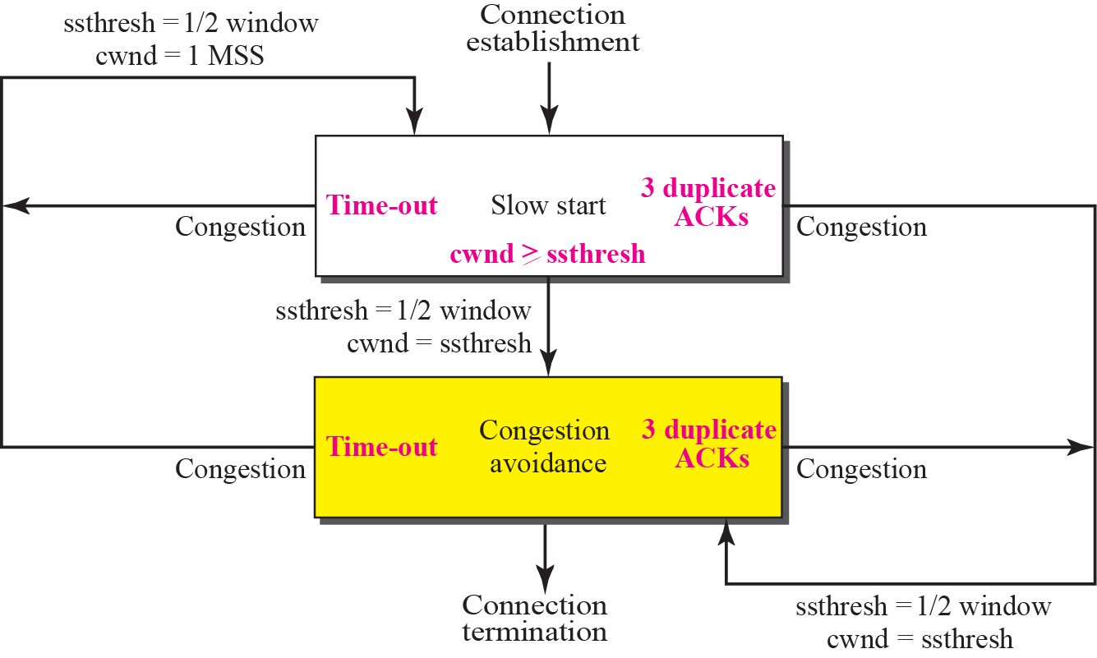
Figure 12-17
TCP Congestion Policy Summary
The McGraw-Hill Companies, Inc., 2000

Slide 166
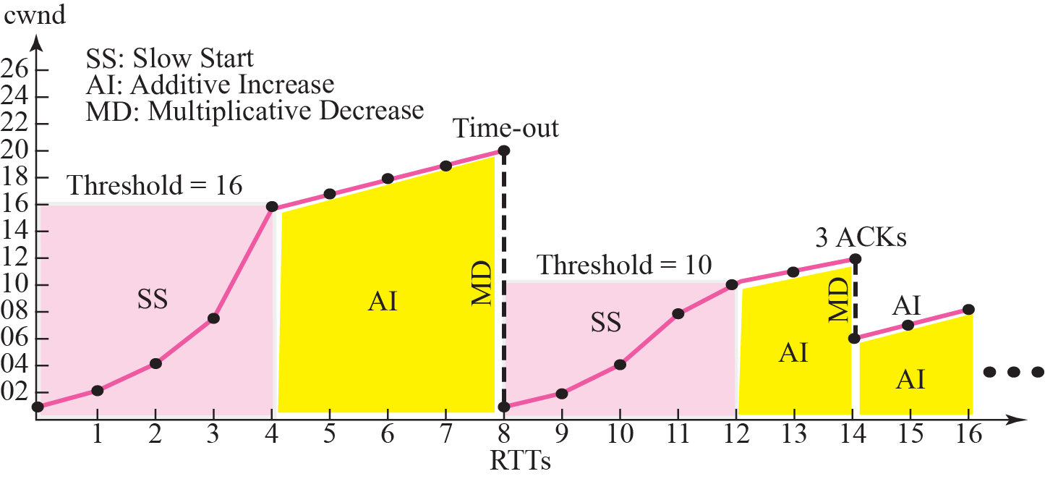
Figure 12-17
Congestion Example
The McGraw-Hill Companies, Inc., 2000

Slide 167
Outline
TCP Services
TCP Features
Segment
A TCP Connection
State Transition Diagram
Windows in TCP
Flow Control
Error Control
Congestion Control
TCP Timers
Options
TCP Package

Slide 168
12.9 TCP TIMERS
To perform its operation smoothly, most TCP implementations use at least four timers.
The topics discussed in this section include:
Retransmission Timer
Persistence Timer
Keepalive Timer
TIME-WAIT Timer

Slide 169
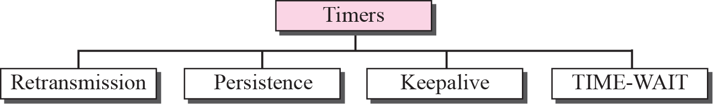
Figure 12-16
TCP Timers
The McGraw-Hill Companies, Inc., 2000

Slide 170
Retransmission Timer
When TCP sends a segment, it creates a retransmission timer to that segment
If an acknowledgment is received before the timer goes off
The timer is destroyed
If timer goes off before an acknowledgment arrives
The segment is retransmitted and the timer is reset

Slide 171
Calculation of Retransmission Timer
TCP cannot use the same retransmission timer for all connections
Each connection has different length and network characteristics
Furthermore, TCP cannot use the same retransmission timer for one single connection
The network behavior is dynamic
Thus, TCP uses the dynamic retransmission timer
Different for each connection and may be changed during the same connection

Slide 172
Calculation of Retransmission Time (Cont.)
Retransmission time-out (RTO) is calculated based on RTT
But, how to calculate RTT?

Slide 173
Calculation of RTT
Measured RTT
Smoothed RTT
RTT Deviation

Slide 174
Measured RTT
Measured RTT: RTT_{M}
How long it takes to send a segment and receive an acknowledgment
Note, segments and their ACKs do not have a one-to-one relationship
Several segments may be acknowledged together
In TCP, only one RTT measurement can be in process at any time

Slide 175
Smoothed RTT
The measured RTT may fluctuation very highly
Cannot be used for RTO purpose
Smooth RTT: RTT_{S}
RTT_{S} = (1-a) RTT_{S} + a x RTT_{M}
a is usually 1/8 percent

Slide 176
RTT Deviation
Most implementation also calculate the RTT deviation, called RTT_{D}
Initially => No value
After first measurement
RTT_{D} = RTT_{M}/2
After any other measurement
RTT_{D}=(1-B)RTT_{D}+Bx |RTT_{S}-RTT_{M}|
B is usually 1/4

Slide 177
Retransmission Timeout (RTO)
Original => Initial value
After any measurement
RTO = RTT_{S} + 4 x RTT_{D}

Slide 178
Example 15.3
Figure 12.38 shows part of a connection. The figure shows the connection establishment and part of the data transfer phases.
1. When the SYN segment is sent, there is no value for RTT_{M} , RTT_{S} , or RTT_{D} . The value of RTO is set to 6.00 seconds.
RTO = 6
2. When the SYN+ACK segment arrives, RTT_{M} is measured and is equal to 1.5 seconds.
RTT_{M} = 1.5 RTT_{S} = 1.5 RTT_{D} = 1.5 / 2 = 0.75 RTO = 1.5 + 4 . 0.75 = 4.5

Slide 179
Example 15.3 (continued)
3.When the first data segment is sent, a new RTT measurement starts. Note that the sender does not start an RTT measurement when it sends the ACK segment, because it does not consume a sequence number and there is no time-out. No RTT measurement starts for the second data segment because a measurement is already in progress.
RTT_{M} = 2.5 RTT_{S} = 7/8 (1.5) + 1/8 (2.5) = 1.625 RTT_{D} = 3/4 (0.75) + 1/4 |1.625 − 2.5| = 0.78 RTO = 1.625 + 4 (0.78) = 4.74

Slide 180
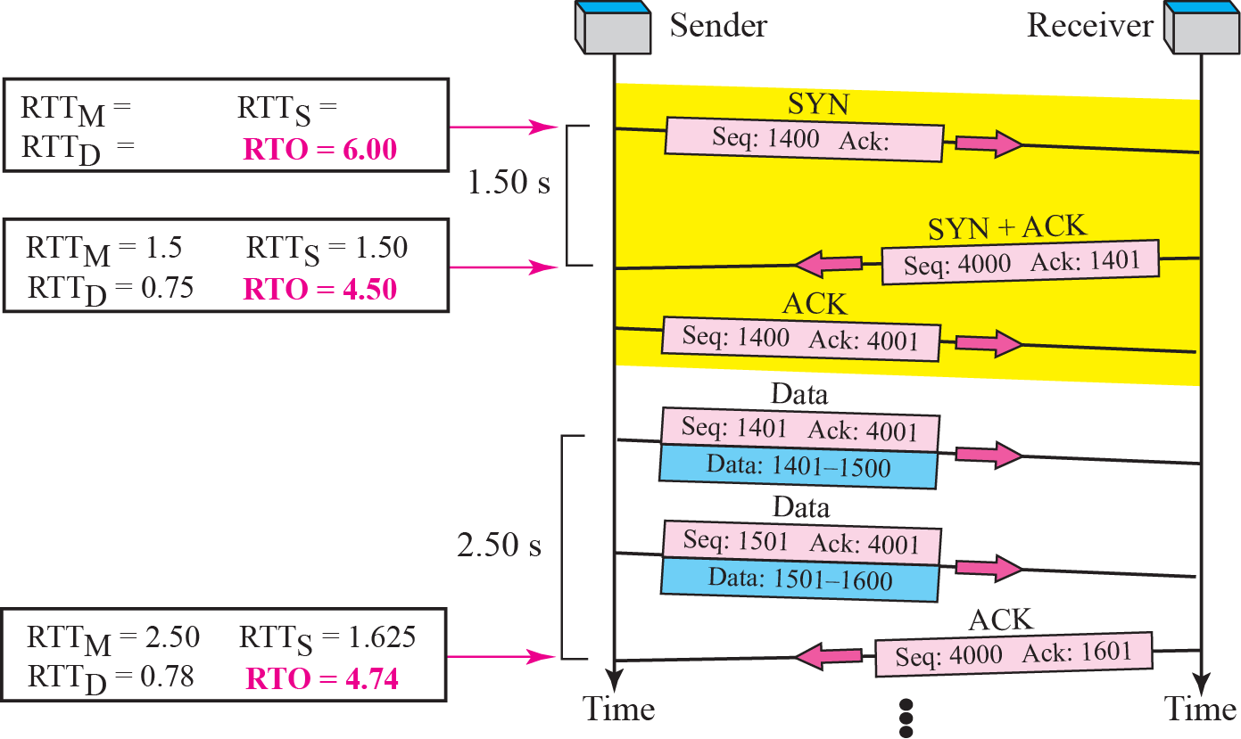

Slide 181
Karn’s Algorithm
Problem
If a segment is not acknowledged during the retransmission timer period and it is retransmitted
When the sending TCP receives an ACK.
It does not know this acknowledgment is for the first one or for the retransmitted one?
Solution: Karn’s algorithm
Do not consider the RTT of a retransmitted segment in the calculation of the new RTT

Slide 182
Exponential Backoff
What is the value of RTO if a retransmission occurs ?
Exponential backoff in TCP
RTO is double for each retransmission

Slide 183
Example 15.4
Next Figure is a continuation of the previous example
There is retransmission and Karn’s algorithm is applied.
The first segment in the figure is sent, but lost.
The RTO timer expires after 4.74 seconds.
The segment is retransmitted and the timer is set to 9.48, twice the previous value of RTO.
This time an ACK is received before the time-out.
Wait until we send a new segment and receive the ACK for it before recalculating the RTO (Karn’s algorithm).

Slide 184
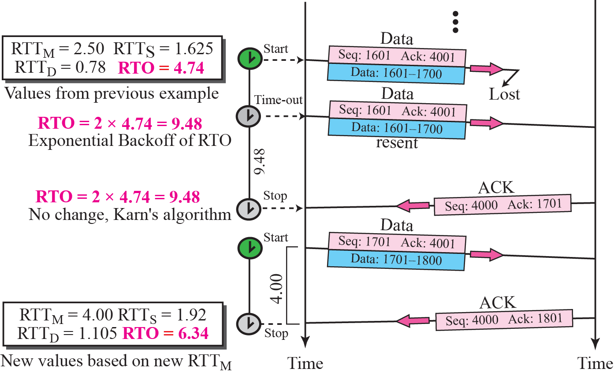

Slide 185
Persistence Timer
TCP needs another timer to deal with the zero window-size advertisement
Example
Receiving TCP announces a window size of zero
The sending TCP stops transmitting segments
After a while, receiving TCP sends an acknowledgment announcing a non-zero window size
However, this acknowledgment was lost
As a result, both sender and receiver continue to wait for each other forever

Slide 186
Persistence Timer (Cont.)
Solution: TCP uses a persistence timer for each connection
When the sending TCP receives an acknowledgment with a window size of zero
It starts a persistence timer
When the timer goes off
The sending TCP sends a special segment called a probe
Contain only 1 byte of data and is never acknowledged
Alert the receiving TCP that the acknowledgment may be lost and should be resent

Slide 187
Persistence Timer (Cont.)
Value of persistence timer is set to the value of the retransmission timer
However, if a response is not received from the receiver
Another probe segment is sent
The value of the persistence timer is double
Above process is repeated until the persistence timer reaches a threshold
Usually 60 seconds

Slide 188
Keepalive Timer
If a client has crashed
A TCP connection will be remain open forever
Solution: Keepalive timer
The time-out is usually 2 hours
If a server does not hear from the client after two hours
Send a probe segment
If there is no response after 10 probes, each of which is 75 seconds apart
It assumes that client is down and terminates the connection

Slide 189
Time-Waited Timer
Used during connection termination
Mentioned later but ignore

Slide 190
Outline
TCP Services
TCP Features
Segment
A TCP Connection
State Transition Diagram
Windows in TCP
Flow Control
Error Control
Congestion Control
TCP Timers
Options
TCP Package (Skip!)

Slide 191
Figure 12-19
TCP Segment Format
The McGraw-Hill Companies, Inc., 2000

Slide 192
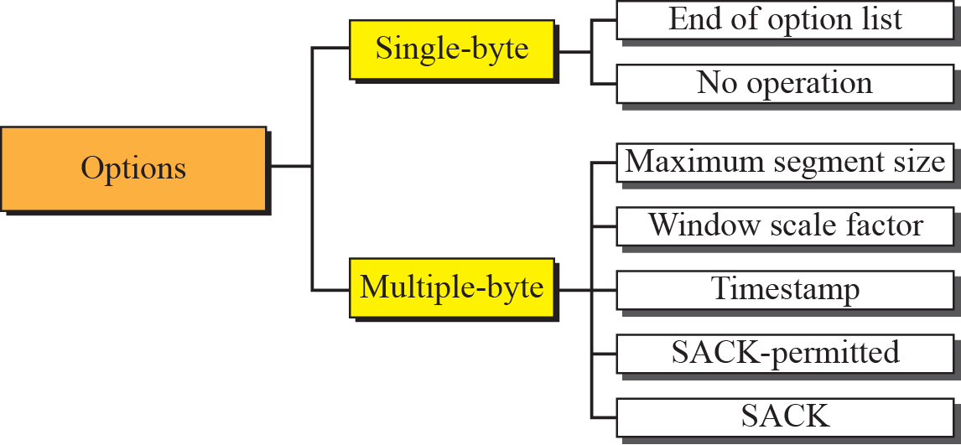
Figure 12-21
Options
The McGraw-Hill Companies, Inc., 2000

Slide 193
No Operation
Used to align the next option on a 32-bit boundary

Slide 194
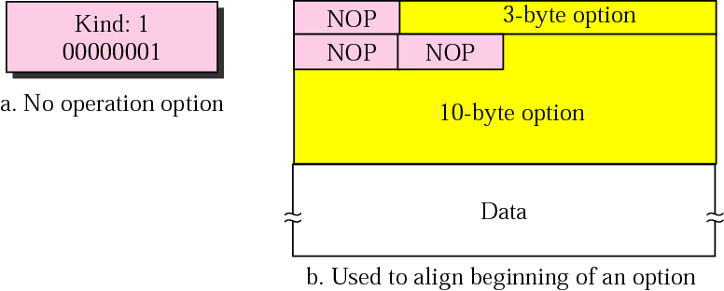
Figure 12-23
No operation Option
The McGraw-Hill Companies, Inc., 2000

Slide 195
End of Option
Used for padding at the end of the option field
Can only be used as the last option
Can be used only once
Only one end of option can be used
If more than 1 byte is needed to align the option field, use some no-operation option followed by an end of option
Two pieces of information to the destination
No more options in the header
Data from the application program starts at the beginning of the next 32-bit word

Slide 196
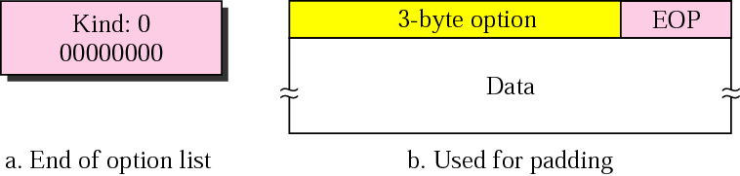
Figure 12-22
End of option Option
The McGraw-Hill Companies, Inc., 2000

Slide 197
Maximum Segment Size (MSS)
Define the size of the biggest chunk of data that can be received by the destination
Notably, it actually defines the maximum size of data, not the maximum size of segment
Determined during the connection establishment phase
Once determined, it does not change during the connection
If neither party defines the size, the default is chosen
Default value is 536

Slide 198
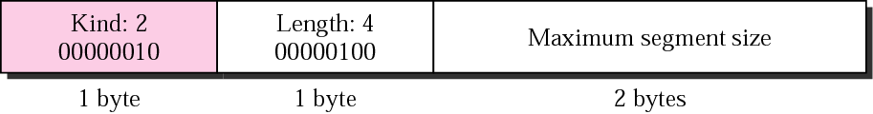
Figure 12-24
Maximum segment size Option
The McGraw-Hill Companies, Inc., 2000

Slide 199
Window Scale Factor
The window size field in the header defines the size of the sliding window
The size of the windows: 0 ~ 65535
However, it may not be sufficient in some networks
To increase the window size, the window scale factor is used
New window size = window size defined in the header x 2^{window scale factor}
However, the window size cannot be greater than the maximum value for the sequence number

Slide 200
Window Scale Factor (Cont.)
Window scale factor can be determined only during the connection setup phase
Thus, during data transfer, the size of the window may be changed
But it must be multiplied by the same scale factor
Cannot be changed during the connection
The scale factor is also called shift count
Multiplying a number by power of 2 = left shift

Slide 201
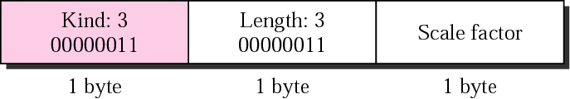
Figure 12-25
Window scale factor Option
The McGraw-Hill Companies, Inc., 2000

Slide 202
Timestamp
Two applications
Measure the round trip time
Prevent wrap around sequence number

Slide 203
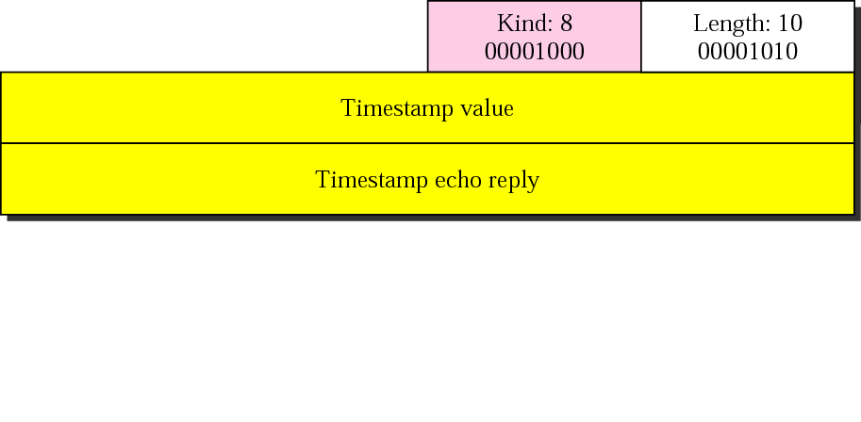
Figure 12-26
Timestamp Option
The McGraw-Hill Companies, Inc., 2000

Slide 204
Measuring RTT
Timestamp value field
Filled by the source when a segment leaves
Timestamp echo reply field
When destination sends an acknowledgement, copy the received timestamp value into the timestamp echo reply field
The source, when it receives acknowledgment
Calculate the round-trip time
Thus, there is no need for clock synchronization
All calculation is based on the sender clock

Slide 205
Measuring RTT (Cont.)
The receiver needs to keep two variables
lastack: the value of the last acknowledgment number sent
tsrecent: the value of recent timestamp that has not yet echoed
Detailed operation is shown in the next example

Slide 206
Example 15.5
The sender simply inserts the value of its system clock in the timestamp field for the first and second segment.
When an acknowledgment comes (the third segment)
The value of the clock is checked and the value of the echo reply field is subtracted from the current time.
RTT is 12 s in this scenario.

Slide 207
Example 15.5 (Continued)
The receiver’s function is more involved.
It keeps track of the last acknowledgment sent (12000).
When the first segment arrives (bytes 12000 to 12099)
The first byte is the same as the value of lastack.
Copy the timestamp value (4720) into the tsrecent variable.
When the second segment arrives
None of the byte numbers in this segment include the value of lastack
The value of the timestamp field is ignored.
When the receiver decides to send an accumulative acknowledgment with acknowledgment 12200
Changes the value of lastack to 12200
Inserts the value of tsrecent in the echo reply field.

Slide 208
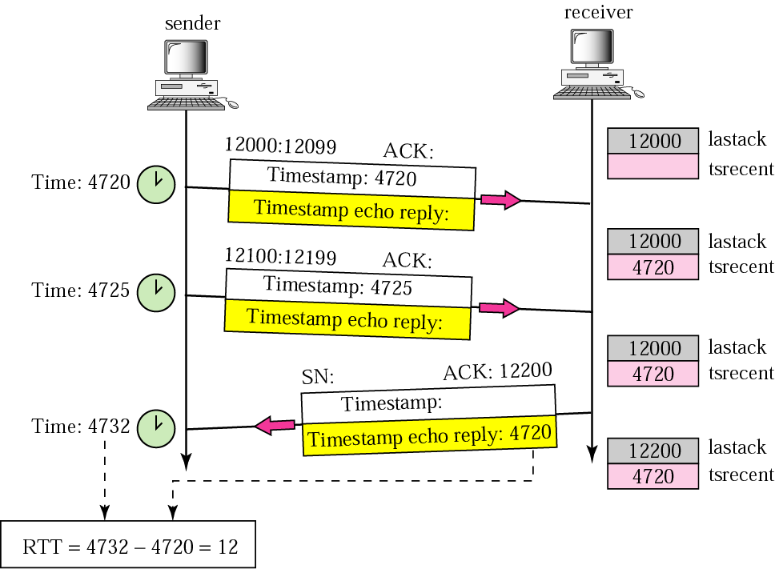

Slide 209
Example 15.5 (Continued)
In this example
RTT is calculated the time difference between sending the first segment and receiving the third segment.
This is actually the meaning of RTT:
The time difference between a packet sent and the acknowledgment received.

Slide 210
PAWS
Timestamp is also used for another application
Protection against wrapped around sequence number (PAWS)
Although sequence number is 32 bits
It could be wrapped around in a high-speed connection
T=0, a sequence number is n
After T=t, the sequence number is also n in the same connection

Slide 211
PAWS (Cont.)
Problem:
If the fist segment is duplicated and arrives during the second round of sequence number
The segment will be wrongly considered belonging to the second run
Solution:
Increase the size of sequence number
Change the window size and segment format
Include the timestamp
The identity of a segment is the combination of timestamp and sequence number

Slide 212
SACK-Permitted and SACK Options
TCP’s ACK is accumulative
Problems
Does not report the bytes that have arrived out of order
Does not report about duplicate segments
Solutions
Selective acknowledgment (SACK)
Thus, two new options
SACK permitted
SACK

Slide 213
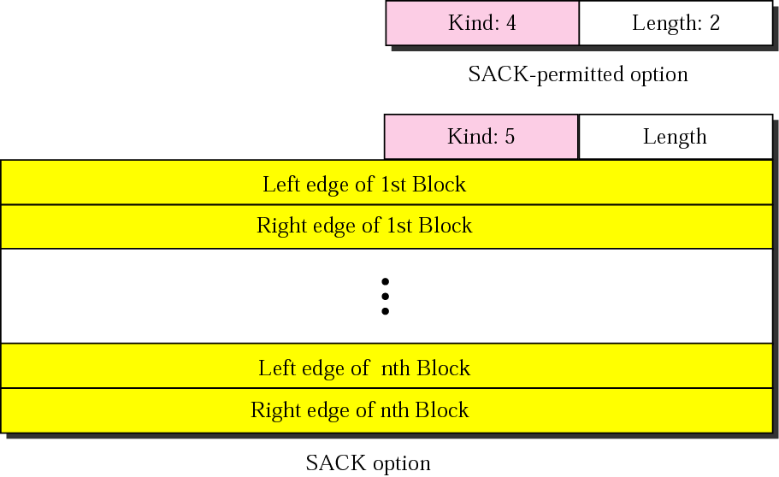
SACK

Slide 214
SACK-Permitted Option
Two bytes used only during connection establishment
Not allowed during the data transfer phase
Sender
SYN segment with SACK-permitted option
Receiver
SYN+ACK segment also with SACK-permitted option

Slide 215
SACK Option
Variable length
Include a list of blocks arriving out-of-order
The first block can also be used to report the duplicates
Each block occupies two 32-bit number
Defining the beginning and the end of the block
SACK option cannot define more than 4 blocks
The allowed size of an option in TCP is 40 bytes
If 5 blocks, (5 x 2) x 4 + 2 = 42 > 40

Slide 216
Example 15.6
The first and second segments are in consecutive order.
Segments 3, 4, and 5 are out of order
A gap between the second and third
Another gap between the fourth and the fifth.
An ACK and a SACK together can easily clear the situation for the sender.
The value of ACK is 2001
Sender need not worry about bytes 1 to 2000.
The SACK has two blocks.
The first block announces that bytes 4001 to 6000 have arrived out of order.
The second block shows that bytes 8001 to 9000 have also arrived out of order.
This means that bytes 2001 to 4000 and bytes 6001 to 8000 are lost or discarded.
The sender can resend only these bytes.

Slide 217
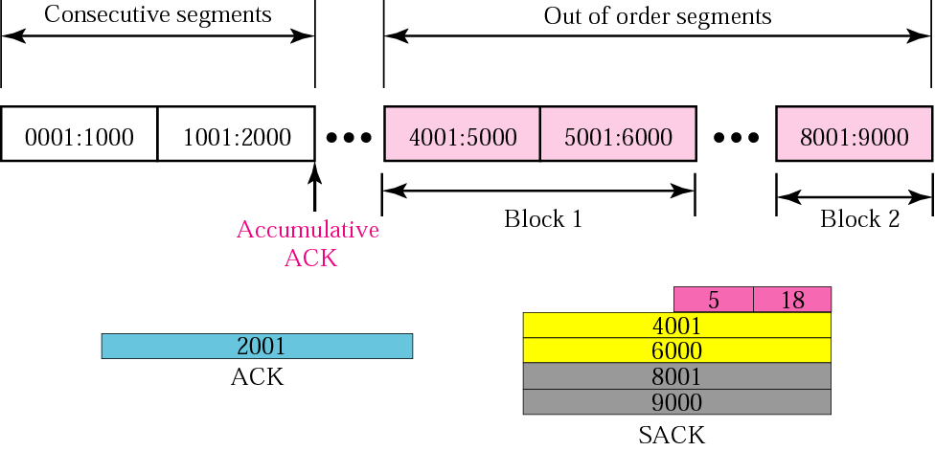
Example 15.6 (Continued)
An end has received five segment of data

Slide 218
Example 15.7
Figure 12.49 shows how a duplicate segment can be detected with a combination of ACK and SACK.
In the figure, we have two out-of-order segments (in one block) and one duplicate segment.
SACK uses the first block to show the duplicate data
Note that only the first block can be used for duplicate data.
The other blocks to show out-of-order data.

Slide 219
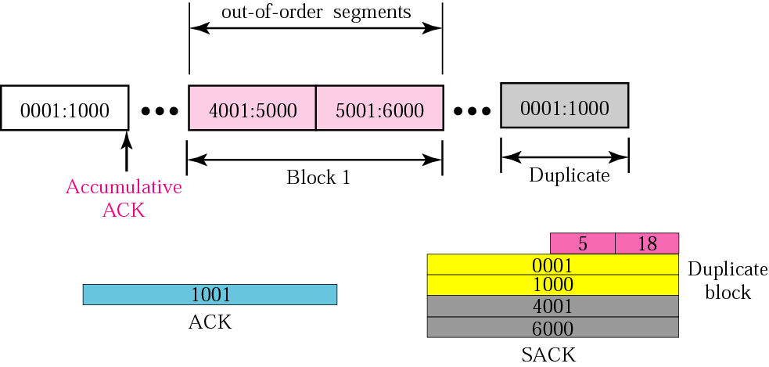
Example 15.7 (Continued)

Slide 220
Example 15.8
The example shows what happens if one of the segments in the out-of-order section is also duplicated.
One of the segments (4001:5000) is duplicated.
The SACK option announces this duplicate data first
Then the out-of-order block.

Slide 221
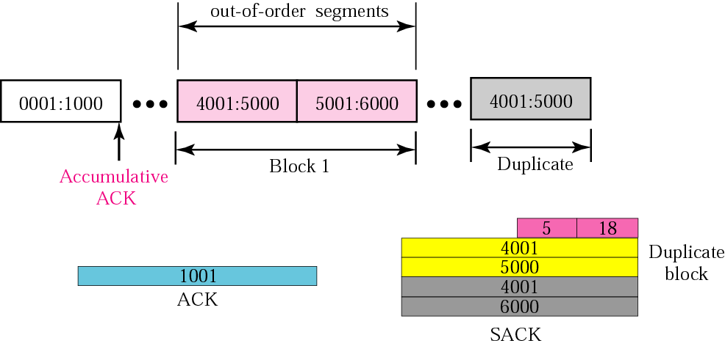
Example 15.8 (Continued)

Slide 222
範圍：CHAPTER 11~15 日期：6/17
第三次考試

